Slide 1
RESIN Schema Library HRF
Phase 2 Evaluation
Version: March 21, 2022

Slide 2
Scenarios
Disease Outbreak
IED Bombing
Terrorist Attack
Kidnapping
Business Change
Election
Sports Games
Mass Shooting
Civil Unrest
International Conflict
Disaster and Rescue

Slide 3
RESIN Epidemic Schema Updated Mar 19, 2022
Sha Li, Manling Li, Ghazaleh Kazeminejad, Michael Regan, Susan Brown, Martha Palmer, Jiawei Han, Heng Ji
{shal2,hengji}@illinois.edu

Slide 4
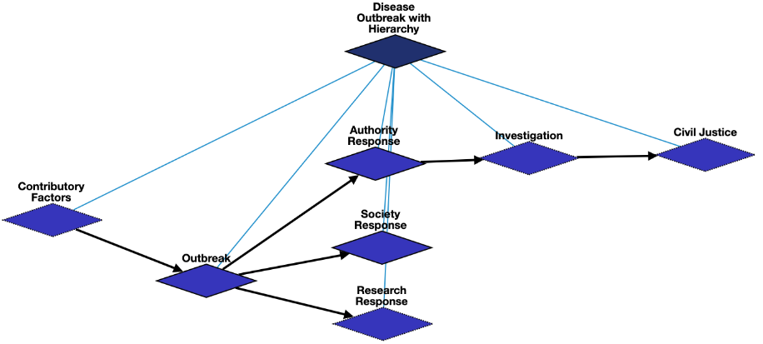
Overview

Slide 5
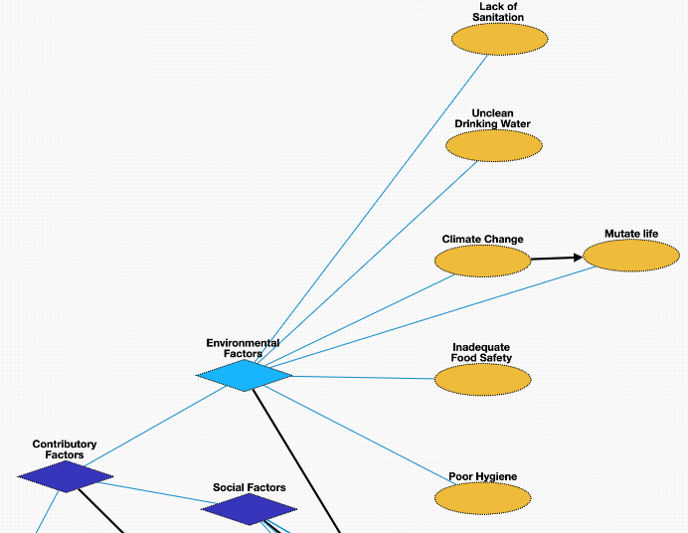
Contributory Factors- Environmental Factors
Lack of Sanitation [negated] : public health conditions related to clean drinking water and adequate disposal of human excreta and sewage
Unclean Drinking Water [negated]: water not safe for consumption
Inadequate Food Safety [negated]: scientific discipline describing handling, preparation, and storage of food in ways that prevent foodborne illness
Poor Hygiene [negated]: set of practices performed for the preservation of health
Climate Change: Contemporary climate change may contribute to the disease outbreak, i.e., global warming
Mutate Life: The virus may undergo an alteration in the nucleotide sequence of the genome during the disease outbreak

Slide 6
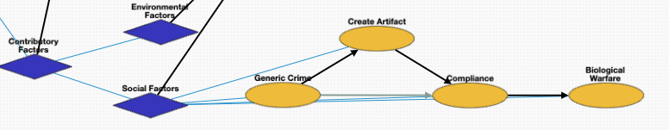
Contributory Factors- Social Factors
Generic Crime: The disease outbreak could be the result of a crime, i.e., someone polluting the water with a chemical
Create Artifact: Creation of a disease by laboratories or organizations
Compliance[negated]: Compliance to a rule or regulation. Often negated, for example violating health regulations.
Biological Warfare: The disease outbreak may result from the use of biological toxins or infectious agents such as bacteria, viruses, insects, and fungi with the intent to kill, harm or incapacitate humans, animals or plants as an act of war

Slide 7
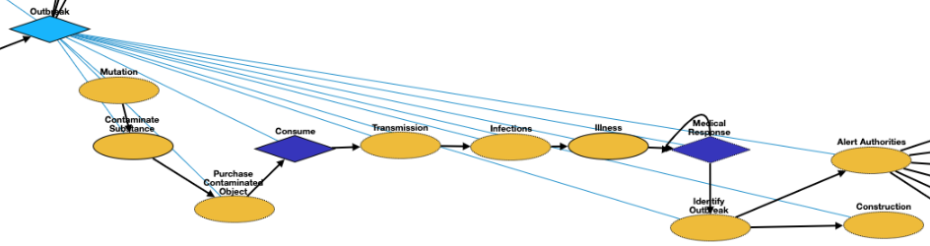
Outbreak
Mutation: The virus may undergo an alteration in the nucleotide sequence of the genome during the disease outbreak
Contaminate Substance: Presence of an unwanted constituent, harmful substance or impurity in a material, physical body, or environment. Contaminated object could be food, liquid or air.
Purchase Contaminated Object: Optionally, the victim purchases the contaminated food or liquid.
Consume: Consumption of a substance by an organism.
Transmission: passing of a pathogen causing communicable disease from an infected host individual or group to other individual or group
Infections: Invasion of an organism's body tissues by the virus. People can be infected by the virus in the disease outbreak
Illness: Abnormal condition that negatively affects the structure or function of all or part of an organism due to the virus in the disease outbreak
Medical Response: [See next page]
Identify Outbreak: Detecting a possible outbreak. Usually accompanied by an announcement.
Alert Authorities: Alerting and reporting the detected outbreak to state and local public health authorities
Construction: Field hospitals may be constructed to accommodate patients during the outbreak

Slide 8
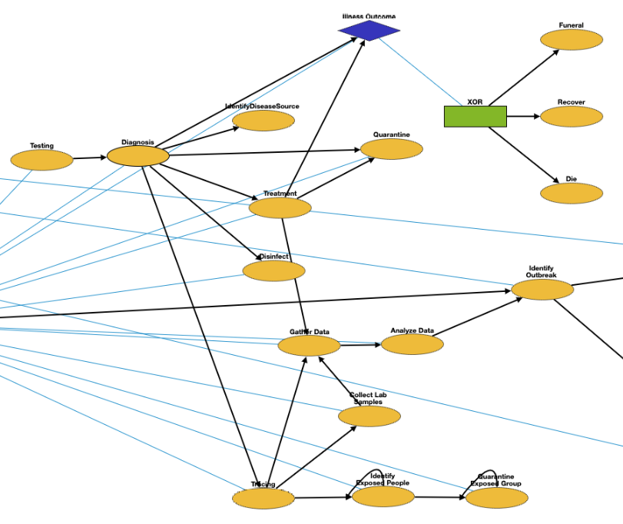
Medical Response
Testing: A viral test checks specimens from your nose or your mouth to find out if you are currently infected with the virus
Diagnosis: Medical diagnosis on infection of the virus in the disease outbreak
IdentifyDiseaseSource: Identify the source of the disease and name the disease if unknown.
Quarantine: Restriction on the movement of people, animals and goods which is intended to prevent the spread of the disease
Disinfect: Cleaning surfaces and substances that are within contact of the pathogen
Treatment: Attempted remediation of a health problem due to infection of the virus in the disease outbreak
Illness Outcome: XOR relation between Recover and Death

Slide 9
Medical Response (cont.)
Tracing: Contact tracing identifies persons who may have come into contact with an infected person during the disease outbreak
Gather Data: Epidemiologic data collection
Analyze Data: process of applying analytical methods to existing data of a specific type
Collect Lab Samples: Collecting and processing samples with the pathogen. These samples may not from the patient directly, but include food, water, surfaces, animals etc.
Identify Exposed People: Identify people exposed to the virus or came into contact with the infected person.
Quarantine Exposed Group: Quarantine and monitor people who came into contact with the infected person.

Slide 10
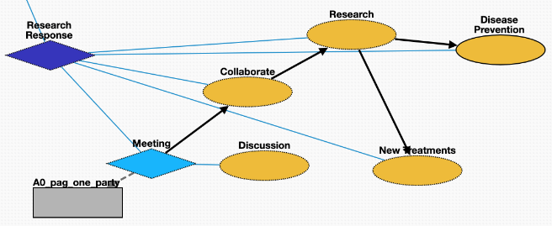
Research Response
Meeting: Academic conference or scientific conference for conducting research on fighting the virus
Discussion: conversation between two or more people on responding to the disease outbreak
Collaborate: Research collaboration on finding treatment for the virus
Research: Conducting research fighting the disease outbreak
New Treatments: Developing effective treatment or cure for the disease
Disease Prevention: acting to avoid the occurrence of certain diseases in an organism or a population

Slide 11
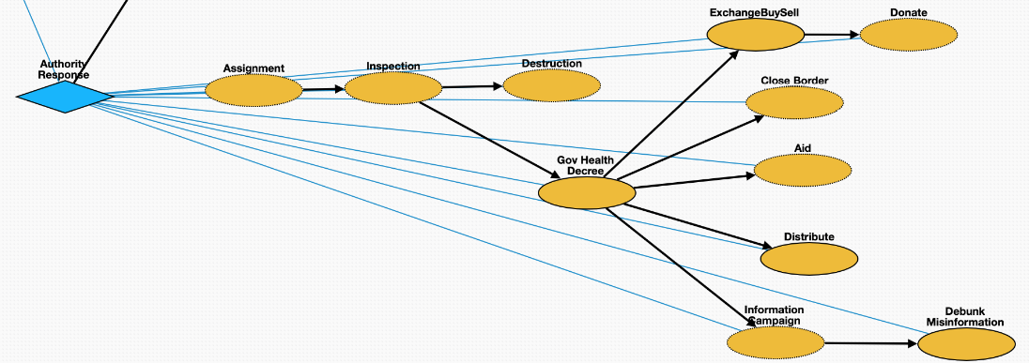
Authority Response
Assignment: Officials are assigned to monitor, prevent, contain, and mitigate the disease outbreak
Inspection: Officials inspect the source of the disease to devise countermeasures
Destruction: Government destroys the source of the disease, for example, Haiti demolished the fishing nuts where the Cholera epidemic started.
Gov Health Decree: Legislations were issued fighting the disease outbreak by government
Information Campaign: Use of media to inform public about the disease
Debunk Misinformation: Debunking misinformation of related to the disease outbreak
Close Border: Border were closed to slow the spread of the virus
Distribute: Distributing the vaccines of the virus
Financial Aid: Financial assistance with food, housing and bills
ExchangeBuySell: Buying, selling or exchanging goods related to the disease outbreak
Donate: Charitable activities related to the disease outbreak

Slide 12
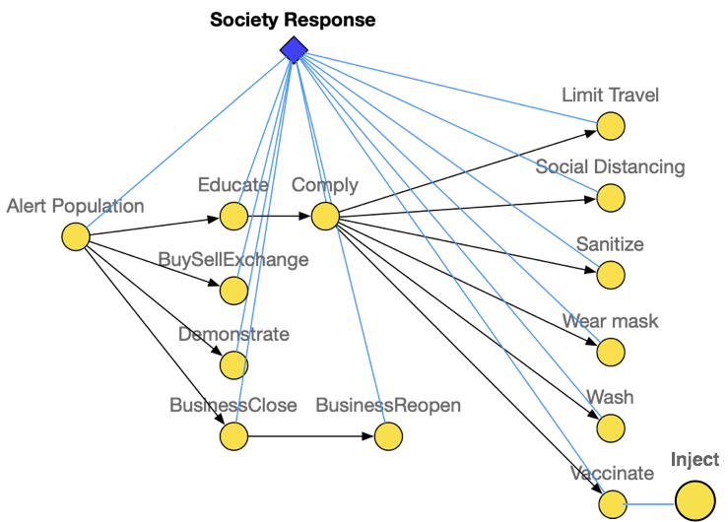
Society Response
Alert Population: Alerting population of the exposure of the virus
Educate: Sharing and educating related knowledge for fighting the disease outbreak
BuySellExchange: Buying, selling or exchanging goods related to the disease outbreak
Demonstrate: Protests over responses to the disease outbreak
BusinessClose: Business close due to the disease outbreak
BusinessReopen: Business reopen due to the disease outbreak
Comply: Complying to the government legislations
Limit Travel: Restrictions on traveling to slow down the spread of the virus
Social Distancing: Keep physical distance to prevent the spread of the disease
Sanitize: Disinfection to prevent infection of the virus
Wear Mask: Wearing masks to prevent the spread of virus
Wash: Washing hands to prevent infection
Vaccinate: Vaccine intended to provide acquired immunity against the virus
Inject: The act of administering a liquid, especially a drug, into a patient infected by the virus using a needle and a syringe

Slide 13
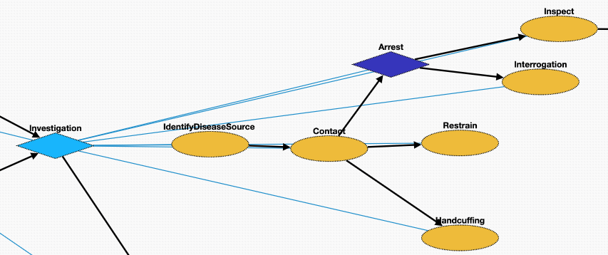
Investigation
IdentifyDiseaseSource: Investigation of the disease outbreak includes identify the source of the virus as well as the suspect of the creator
Contact: Make contact with the suspect
Arrest: Taking the suspect who created the virus or violated laws during the outbreak into custody
Inspect: Organized examination or formal evaluation on the suspect for creating the virus
Interrogation: Interviewing with the goal of eliciting useful information related to suspected crime during the disease outbreak
Handcuffing: Using handcuffs to secure a suspect who violated law during the disease outbreak
Restrain: Physical restraint on the suspect

Slide 14
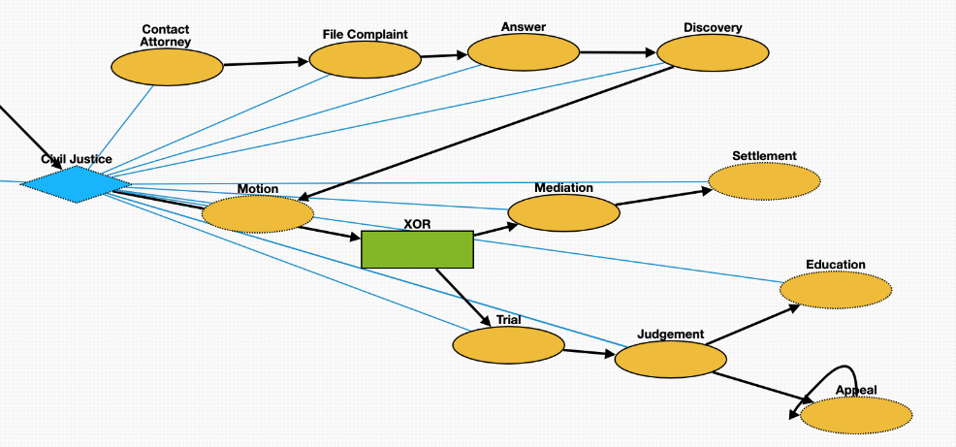
Civil Justice
File Complaint: Plaintiff files a complaint to initiate a lawsuit
Answer: In law, a solemn assertion in opposition to someone or something by the defendant
Discovery: Pre-trial procedure in common law countries for obtaining evidence
Motion: In US law, a procedural device to bring a limited, contested issue before a court for decision
Trial: Coming together of parties to a dispute, to present information in a tribunals on the case of creation of the virus
Judgement: The formal decision made by a court following a lawsuit
Education: learning in which knowledge and skills are transferred through teaching. The defendant is educated about regulations.
Appeal: Resort to a superior court to review the decision of an inferior court or administrative agency
Mediation: Dispute resolution with assistance of an impartial third party moderator through the use of communication and negotiation techniques
Settlement: The dispute is resolved through a payment of money.

Slide 15
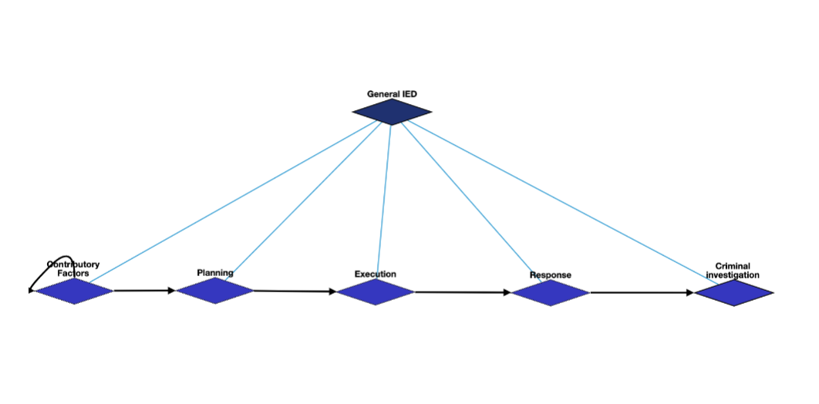
General IED Schema Overview

Slide 16
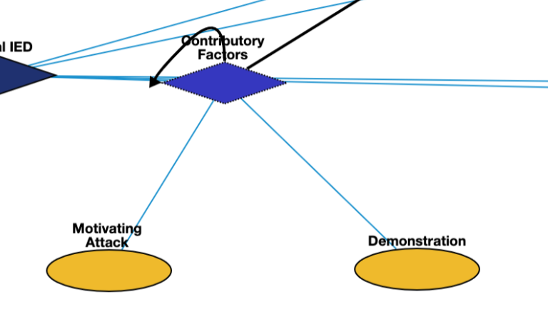

General IED: Contributory Factors
Motivating Attack | Q1174599 | Motivation for attack
Demonstration | Q175331 | demonstration that triggered the bomb

Slide 17
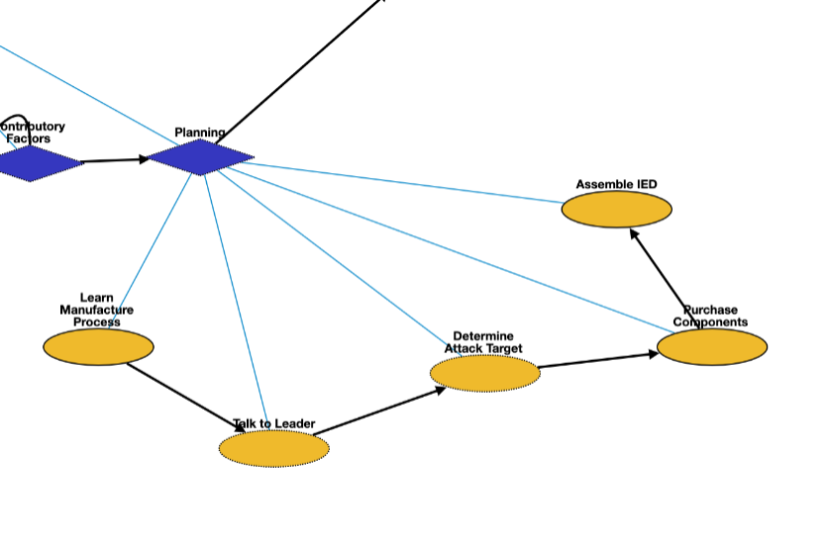
General IED: Planning
Learn manufacture process | Q8434 | learn about the manufacture process
Talking to leader | Q1472062 | asking the leader about the bomb plan
Determine attack target | Q1665268 | requester asks to determine a specific target
Purchase components | Q21651837 | buy the materials to make the bomb
Assemble IED | Q187939 | manufacturing the bomb

Slide 18
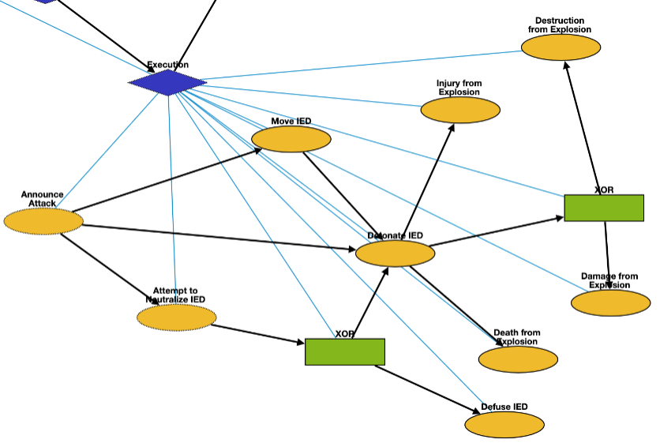
General IED: Execution
Announce Attack | Q325980 | announce the possible bombing
Attempt to Neutralize IED | Q5185976 | police move in to interfere with and neutralize IED
Move IED | Q7590 | transport the bomb to the target
Detonate IED | Q891854 | bomb attack starts
Defuse IED | Q649416 | leave the bomb
Death from Explosion | Q4 | death of victims
Damage from Explosion | Q481609 | damage of the target
Injury from Explosion | Q193078 | injury of victims
Destruction from Explosion | Q17781833 | destruction of the target

Slide 19
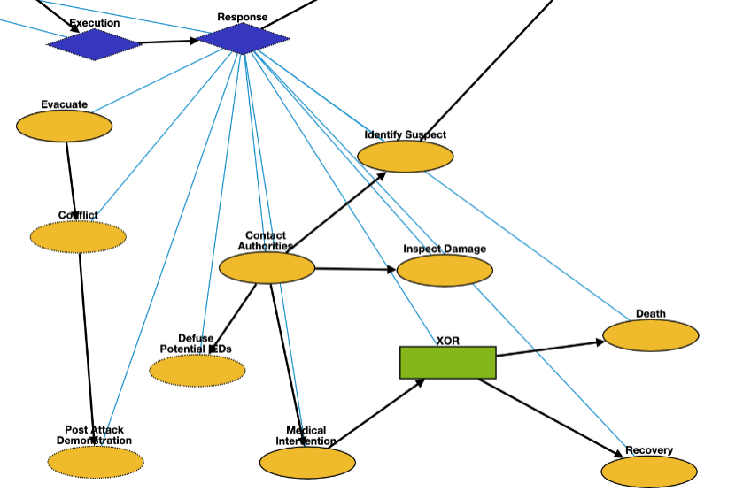
General IED: Response
Evacuate | Q606332 | emergency_evacuation
Conflict | Q1174599 | attack after the bombing
Post Attack Demonstration | Q175331 | demonstration after the bombing
Defuse Potential IEDs | Q649416 | Defuse potential IEDs still in the area
Contact Authorities | Q1472062 | contacting authorities and inform them of the explosion
Medical Intervention | Q179661 | Treat victims injured by the IED explosion
Identify Suspect | Q3265221 | identification of the bomber
Inspect Damage | Q193181 | Observe damage of the target location
Death | Q4 | Death after medical intervention
Recovery | Q7302970 | Victim recovers from injury

Slide 20
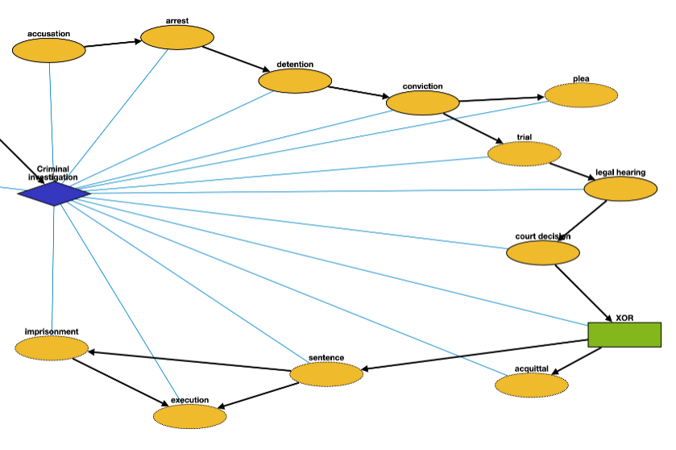
General IED: Criminal Investigation
Accusation | Q19357312 | Accusing or charging another with a crime
Arrest | Q1403016 | Arrest a person
Detention | Q1071447 | Removal of the freedom
Conviction | Q2916183 | Find a defendant guilty of a crime
Plea | Q15916459 | Answer to a claim
Trial | Q8016240 | Present information in a tribunal
Legal Hearing | Q545861 | A legal hearing
Court Decision | Q327000 | Formal decision made by a court
Acquittal | Q1454723 | The legal result of a verdict of not guilty
Sentence | Q1763090 | Decree of punishment in a law
Execution | Q3966286 | Homicide as capital punishment
Imprisonment | Q841236 | Restraint of a person’s liberty

Slide 21
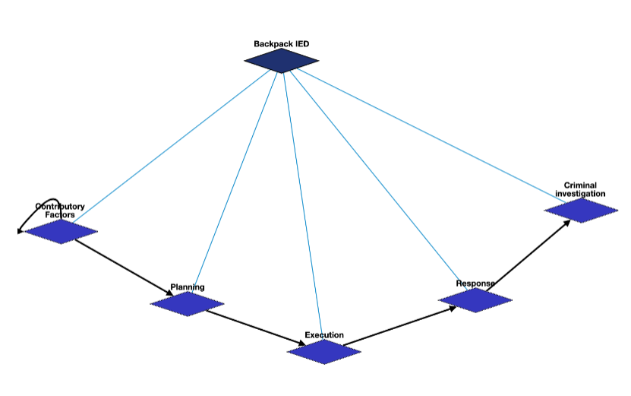
Backpack IED

Slide 22
Backpack IED: Contributory Factors
Motivating Attack | Q1174599 | Motivation for attack
Demonstration | Q175331 | demonstration that triggered the bomb

Slide 23
Backpack IED: Planning
Learn manufacture process | Q8434 | learn about the manufacture process
Talking to leader | Q1472062 | asking the leader about the bomb plan
Determine attack target | Q1665268 | requester asks to determine a specific target
Purchase components | Q21651837 | buy the materials to make the bomb
Assemble IED | Q187939 | manufacturing the bomb

Slide 24
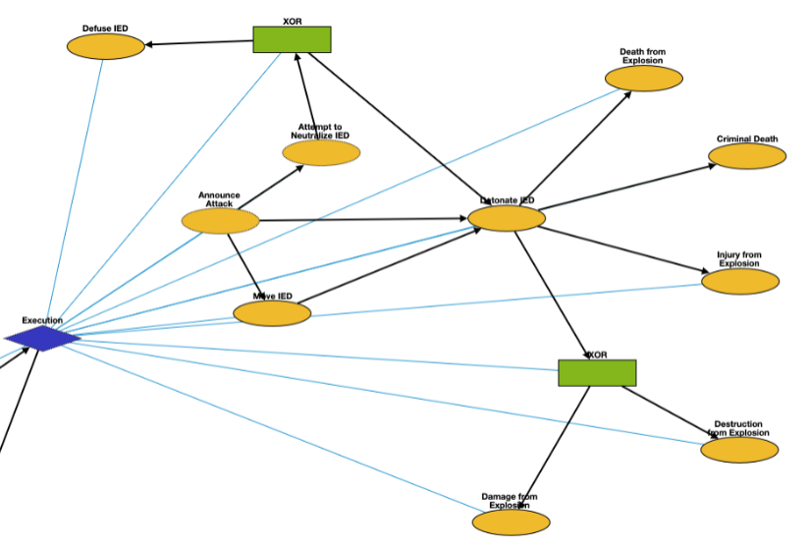
Backpack IED: Execution
Announce Attack | Q325980 | announce the possible bombing
Attempt to Neutralize IED | Q5185976 | police move in to interfere with and neutralize IED
Move IED | Q7590 | transport the bomb to the target
Detonate IED | Q891854 | bomb attack starts
Defuse IED | Q649416 | leave the bomb
Death from Explosion | Q4 | death of victims
Criminal Death | Q4 | Criminal is killed in explosion
Damage from Explosion | Q481609 | damage of the target
Injury from Explosion | Q193078 | injury of victims
Destruction from Explosion | Q17781833 | destruction of the target

Slide 25
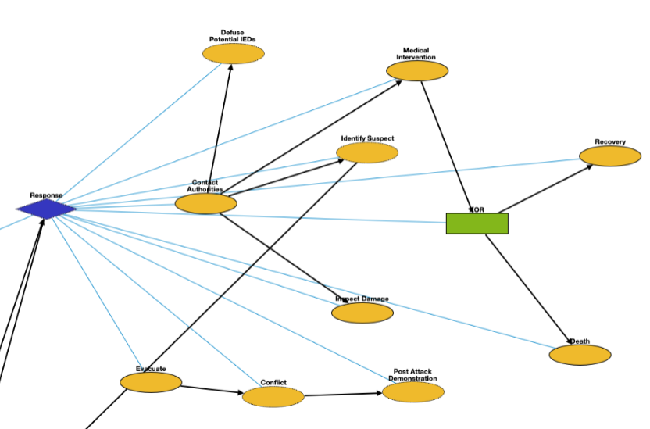
Backpack IED: Response
Evacuate | Q606332 | emergency_evacuation
Conflict | Q1174599 | attack after the bombing
Post Attack Demonstration | Q175331 | demonstration after the bombing
Defuse Potential IEDs | Q649416 | Defuse potential IEDs still in the area
Contact Authorities | Q1472062 | contacting authorities and inform them of the explosion
Medical Intervention | Q179661 | Treat victims injured by the IED explosion
Identify Suspect | Q3265221 | identification of the bomber
Inspect Damage | Q193181 | Observe damage of the target location
Death | Q4 | Death after medical intervention
Recovery | Q7302970 | Victim recovers from injury

Slide 26
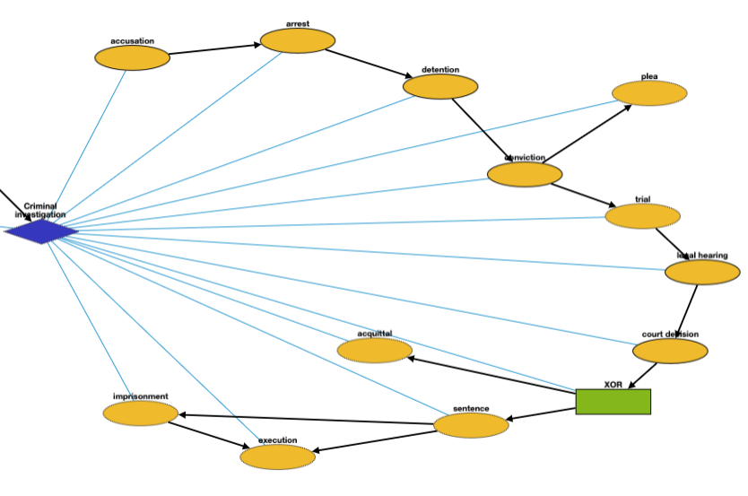
Backpack IED: Criminal Investigation
Accusation | Q19357312 | Accusing or charging another with a crime
Arrest | Q1403016 | Arrest a person
Detention | Q1071447 | Removal of the freedom
Conviction | Q2916183 | Find a defendant guilty of a crime
Plea | Q15916459 | Answer to a claim
Trial | Q8016240 | Present information in a tribunal
Legal Hearing | Q545861 | A legal hearing
Court Decision | Q327000 | Formal decision made by a court
Acquittal | Q1454723 | The legal result of a verdict of not guilty
Sentence | Q1763090 | Decree of punishment in a law
Execution | Q3966286 | Homicide as capital punishment
Imprisonment | Q841236 | Restraint of a person’s liberty

Slide 27
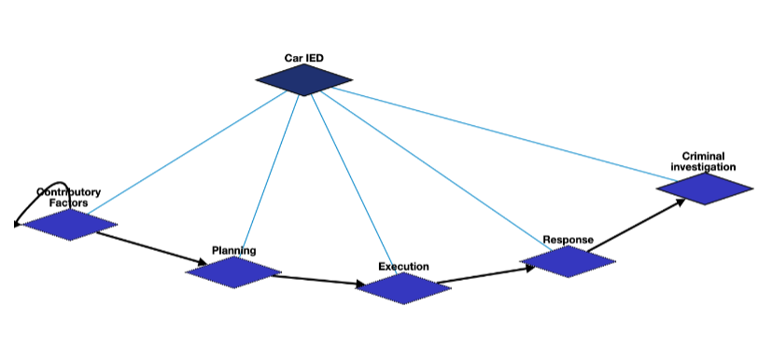
Car IED

Slide 28
Car IED: Contributory Factors
Motivating Attack | Q1174599 | Motivation for attack
Demonstration | Q175331 | demonstration that triggered the bomb

Slide 29
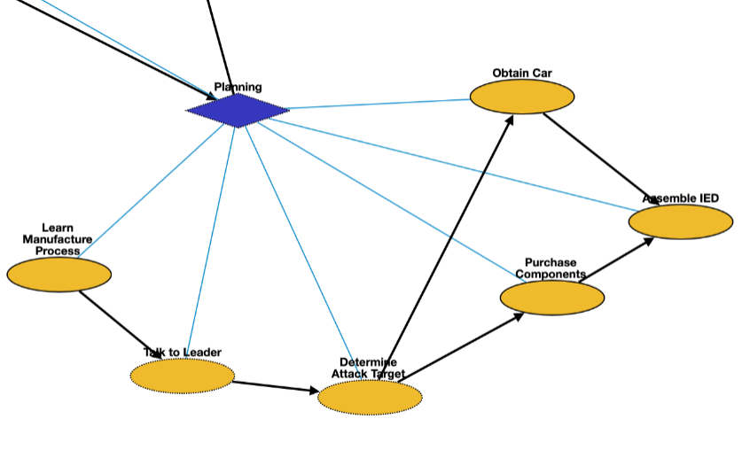
Car IED: Planning
Learn manufacture process | Q8434 | learn about the manufacture process
Talking to leader | Q1472062 | asking the leader about the bomb plan
Determine attack target | Q1665268 | requester asks to determine a specific target
Purchase components | Q21651837 | buy the materials to make the bomb
Assemble IED | Q187939 | manufacturing the bomb
Obtain Car | Q21651837 | Obtain car to hold the IED with

Slide 30
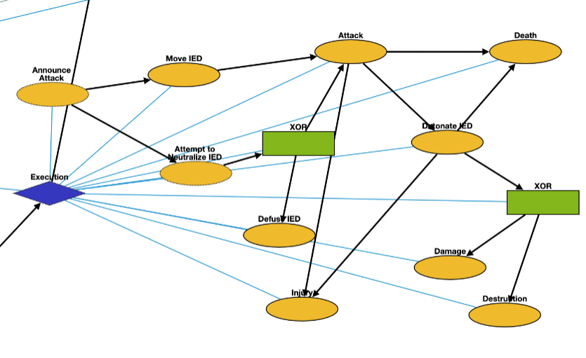
Car IED: Execution
Announce Attack | Q325980 | announce the possible bombing
Attempt to Neutralize IED | Q5185976 | police move in to interfere with and neutralize IED
Move IED | Q7590 | transport the bomb to the target
Detonate IED | Q891854 | bomb attack starts
Defuse IED | Q649416 | leave the bomb
Attack | Q1174599 | Terrorists attack target location with car
Death | Q4 | death of victims
Injury | Q193078 | injury of victims
Damage | Q481609 | damage of the target
Destruction | Q17781833 | destruction of the target

Slide 31
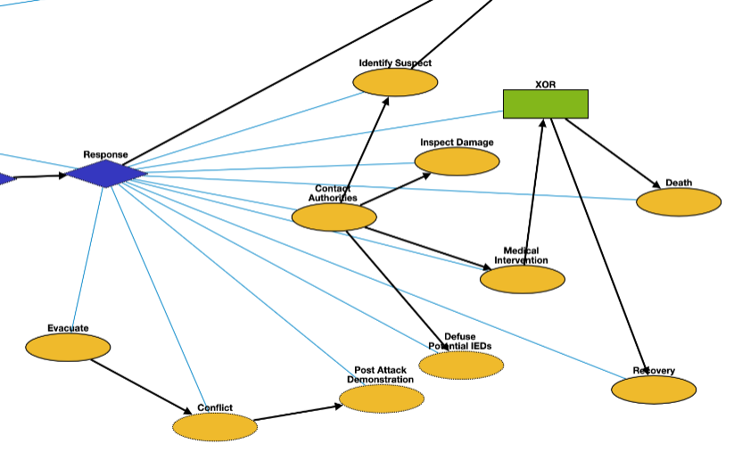
Car IED: Response
Evacuate | Q606332 | emergency_evacuation
Conflict | Q1174599 | attack after the bombing
Post Attack Demonstration | Q175331 | demonstration after the bombing
Defuse Potential IEDs | Q649416 | Defuse potential IEDs still in the area
Contact Authorities | Q1472062 | contacting authorities and inform them of the explosion
Medical Intervention | Q179661 | Treat victims injured by the IED explosion
Identify Suspect | Q3265221 | identification of the bomber
Inspect Damage | Q193181 | Observe damage of the target location
Death | Q4 | Death after medical intervention
Recovery | Q7302970 | Victim recovers from injury

Slide 32
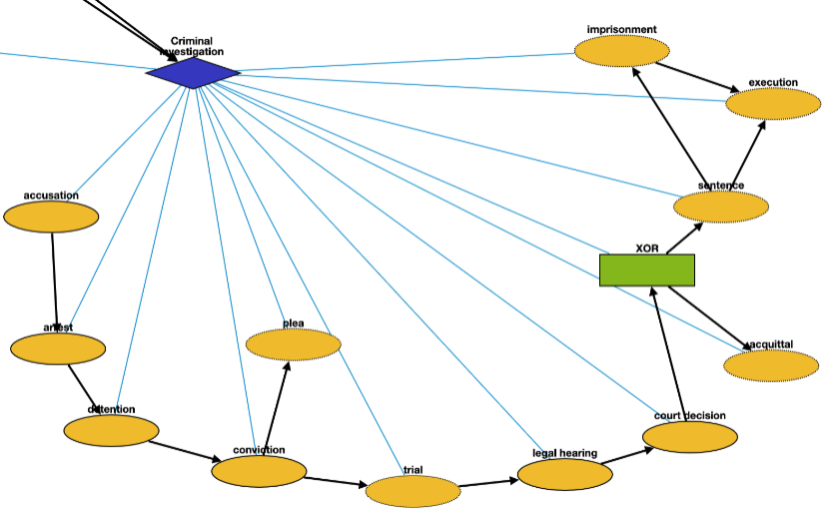
Car IED: Criminal Investigation
Accusation | Q19357312 | Accusing or charging another with a crime
Arrest | Q1403016 | Arrest a person
Detention | Q1071447 | Removal of the freedom
Conviction | Q2916183 | Find a defendant guilty of a crime
Plea | Q15916459 | Answer to a claim
Trial | Q8016240 | Present information in a tribunal
Legal Hearing | Q545861 | A legal hearing
Court Decision | Q327000 | Formal decision made by a court
Acquittal | Q1454723 | The legal result of a verdict of not guilty
Sentence | Q1763090 | Decree of punishment in a law
Execution | Q3966286 | Homicide as capital punishment
Imprisonment | Q841236 | Restraint of a person’s liberty

Slide 33
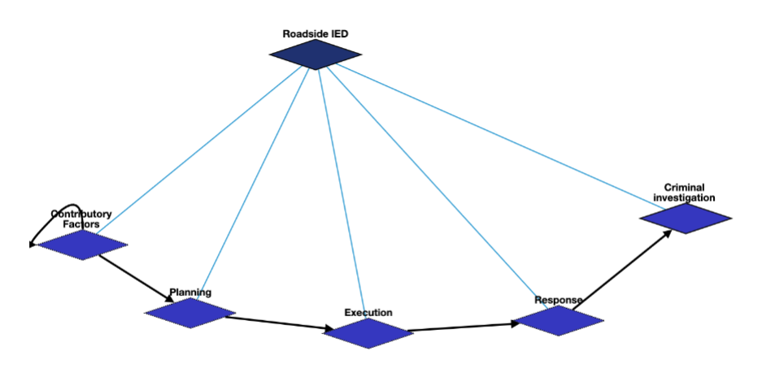
Roadside IED Schema Overview

Slide 34
Roadside IED: Contributory Factors
Motivating Attack | Q1174599 | Motivation for attack
Demonstration | Q175331 | demonstration that triggered the bomb

Slide 35
Roadside IED: Planning
Learn manufacture process | Q8434 | learn about the manufacture process
Talking to leader | Q1472062 | asking the leader about the bomb plan
Determine attack target | Q1665268 | requester asks to determine a specific target
Purchase components | Q21651837 | buy the materials to make the bomb
Assemble IED | Q187939 | manufacturing the bomb

Slide 36
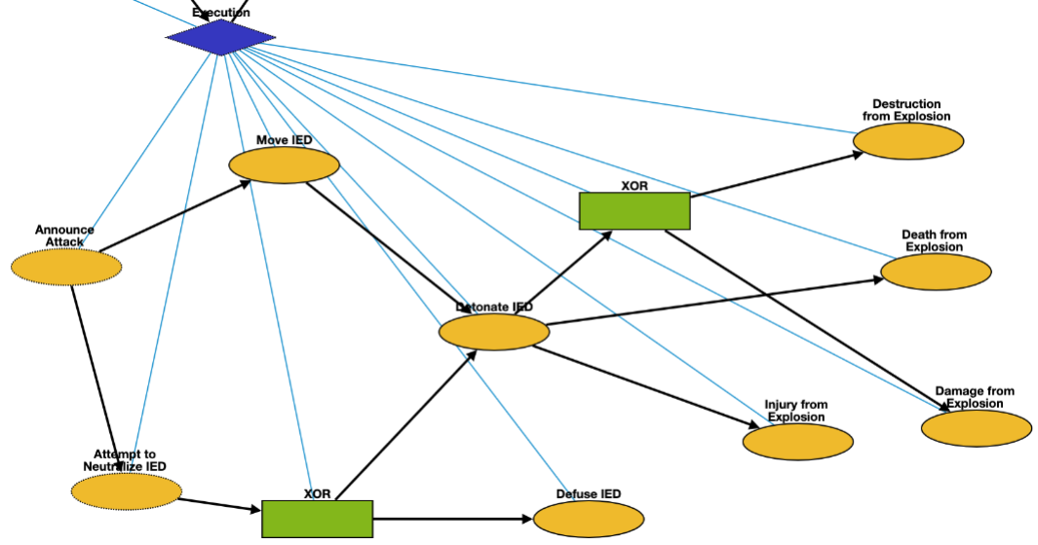
Roadside IED: Execution
Announce Attack | Q325980 | announce the possible bombing
Attempt to Neutralize IED | Q5185976 | police move in to interfere with and neutralize IED
Move IED | Q7590 | transport the bomb to the target
Detonate IED | Q891854 | bomb attack starts
Defuse IED | Q649416 | leave the bomb
Death from Explosion | Q4 | death of victims
Damage from Explosion | Q481609 | damage of the target
Injury from Explosion | Q193078 | injury of victims
Destruction from Explosion | Q17781833 | destruction of the target

Slide 37
Roadside IED: Response
Evacuate | Q606332 | emergency_evacuation
Conflict | Q1174599 | attack after the bombing
Post Attack Demonstration | Q175331 | demonstration after the bombing
Defuse Potential IEDs | Q649416 | Defuse potential IEDs still in the area
Contact Authorities | Q1472062 | contacting authorities and inform them of the explosion
Medical Intervention | Q179661 | Treat victims injured by the IED explosion
Identify Suspect | Q3265221 | identification of the bomber
Inspect Damage | Q193181 | Observe damage of the target location
Death | Q4 | Death after medical intervention
Recovery | Q7302970 | Victim recovers from injury

Slide 38
Roadside IED: Criminal Investigation
Accusation | Q19357312 | Accusing or charging another with a crime
Arrest | Q1403016 | Arrest a person
Detention | Q1071447 | Removal of the freedom
Conviction | Q2916183 | Find a defendant guilty of a crime
Plea | Q15916459 | Answer to a claim
Trial | Q8016240 | Present information in a tribunal
Legal Hearing | Q545861 | A legal hearing
Court Decision | Q327000 | Formal decision made by a court
Acquittal | Q1454723 | The legal result of a verdict of not guilty
Sentence | Q1763090 | Decree of punishment in a law
Execution | Q3966286 | Homicide as capital punishment
Imprisonment | Q841236 | Restraint of a person’s liberty

Slide 39
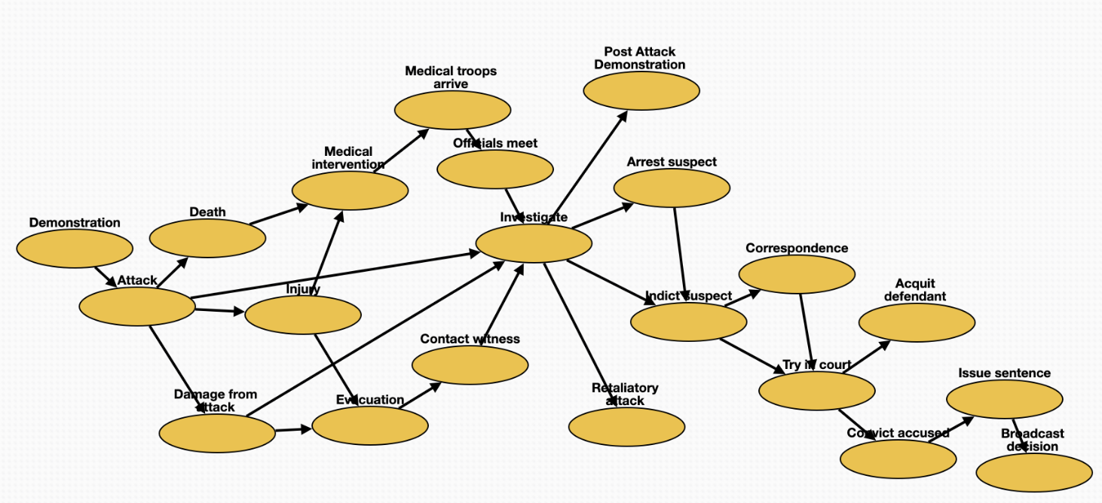
General Attack Schema
Medical intervention | Q179661 | treatment of the victims
Arrest suspect | Q1403016 | arrest suspects
Try in court | Q545861 | legal_hearing
Officials meet | Q21170798 | meeting with officials
Investigate | Q1964968 | criminal_investigation
Evacuation | Q606332 | emergency_evacuation
Contact witness | Q11024 | communication with witness
Demonstration | Q175331 | demonstration that triggered the attack
Post-Attack Demonstration | Q175331 | demonstration after the attack
Retaliatory attack | Q1174599 | attack after the previous attack
Indict suspect | Q19357312 | accusation of the attacker
Correspondence | Q1472062 | remote_communication
Convict accused | Q2916183 | conviction of the attacker
Broadcast decision | Q567303 | announcement
Issue sentence | Q1763090 | sentence
Attack | Q1174599 | attack happens
Damage from attack | Q481609 | damage from the attack
Acquit defendant | Q1454723 | acquittal of the attacker
Death | Q4 | death of the victims
Medical troops arrive | Q7590 | medical team arrives
Injury | Q193078 | injury of victims

Slide 40
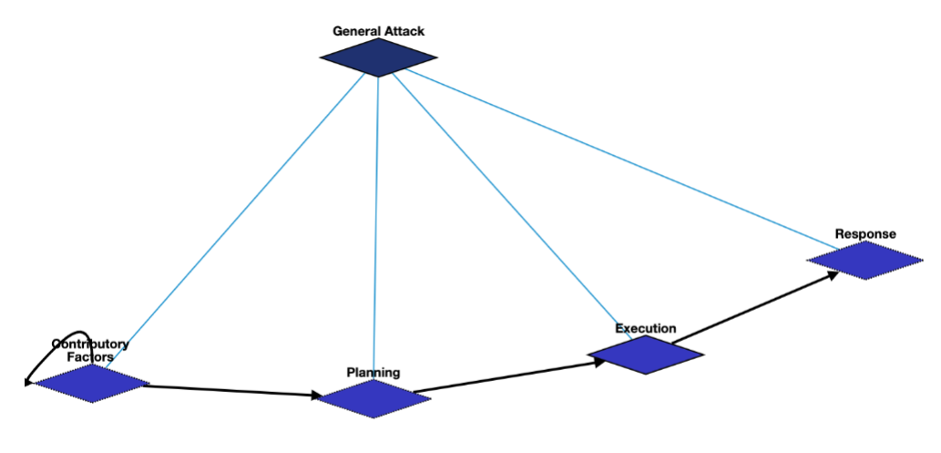
General Attack

Slide 41
General Attack: Contributory Factors
Motivating Attack | Q1174599 | Motivation for attack
Demonstration | Q175331 | demonstration that triggered the bomb

Slide 42
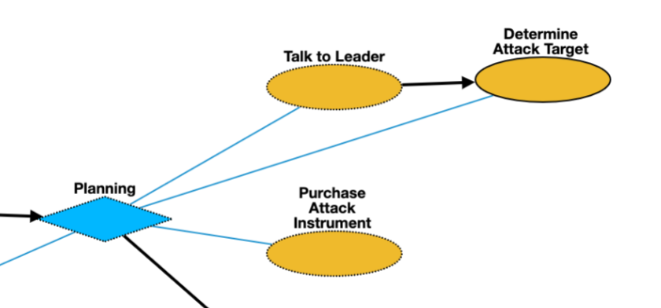
General Attack: Planning
Talk to leader | Q1472062 | asking the leader about the bomb plan
Determine attack target | Q1665268 | requester asks to determine a specific target
Purchase Attack Instrument | Q21651837 | Purchase Attack Instrument

Slide 43
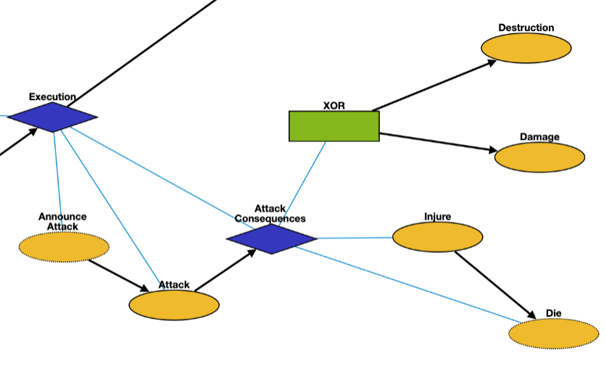
General Attack: Execution
Announce Attack | Q325980 | announce the possible bombing
Attack | Q1174599 | attack
Death | Q4 | death of victims
Damage | Q481609 | damage of the target
Injure | Q193078 | injury of victims
Destruction | Q17781833 | destruction of the target

Slide 44
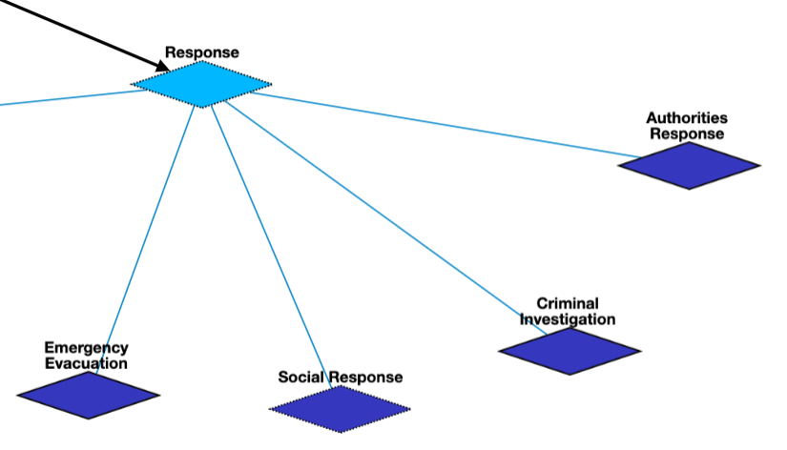
General Attack: Response

Slide 45
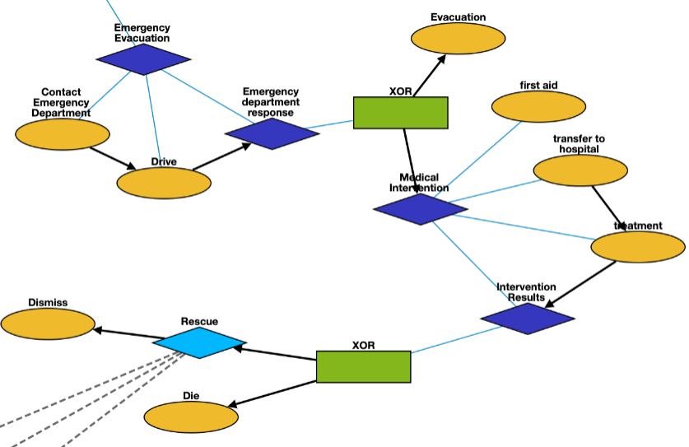
General Attack: Emergency Evacuation
Contact Emergency Department | Q1472062 | Contact the emergency department for help
Drive | Q7590 | Medical team drives to attack site
Evacuation | Q606332 | Evacuate target premises
First Aid | Q133981 | On-site intervention, including first and immediate assistance
Transfer to Hospital | Q7590 | Drive to medical facility
Treatment | Q179661 | Medical intervention at hospital
Die | Q4 | Ultimate death in the hospital when medical intervention is unsuccessful
Dismiss | Q47328472 | Dismiss from hospital

Slide 46
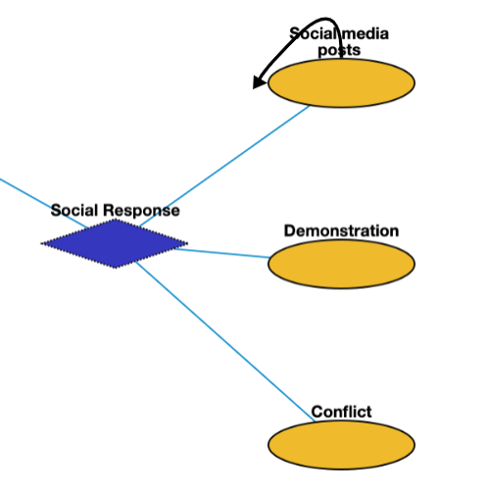
General Attack: Social Response
Social media postsc | Q7216866 | Social media posts
Demonstration | Q175331 | Post-attack demonstration
Conflict | Q180684 | Conflict after the attack, possibly directed towards a group that the crime committer is a part of

Slide 47
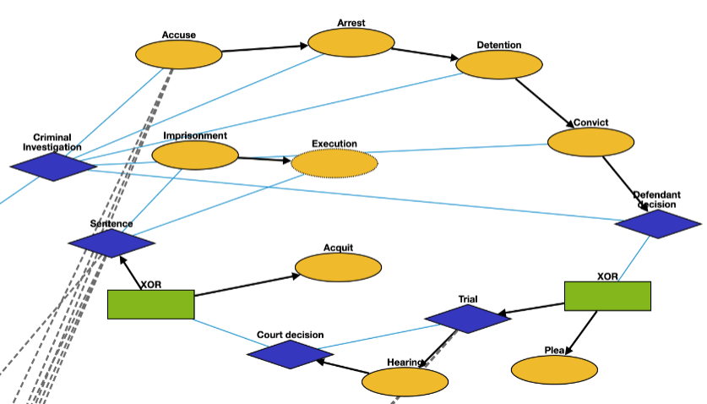
General Attack: Criminal Investigation
Accuse | Q19357312 | Accusing or charging another with a crime
Arrest | Q1403016 | Arrest a person
Detention | Q1071447 | Removal of the freedom
Convict | Q2916183 | Find a defendant guilty of a crime
Plea | Q15916459 | Answer to a claim
Hearing | Q545861 | A legal hearing
Acquit | Q1454723 | The legal result of a verdict of not guilty
Execution | Q3966286 | Homicide as capital punishment
Imprisonment | Q841236 | Restraint of a person’s liberty

Slide 48
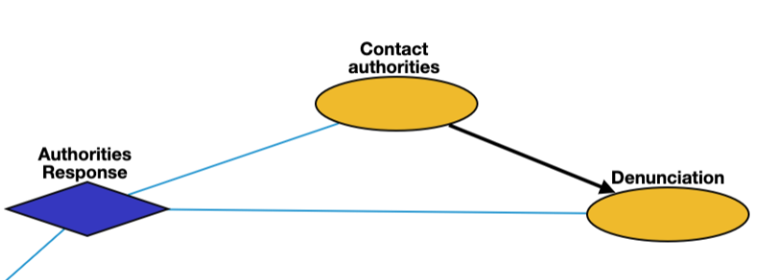
General Attack: Authorities Response
Contact authorities | Q1472062 | Contact authorities and inform them of the attack
Denunciation | Q1189956 | denunciation

Slide 49
RESIN Terrorist Attacks Schema Updated March 20, 2022
Iris Liu, Sha Li, Michael Regan,
Susan Brown, Martha Palmer, Heng Ji

Slide 50
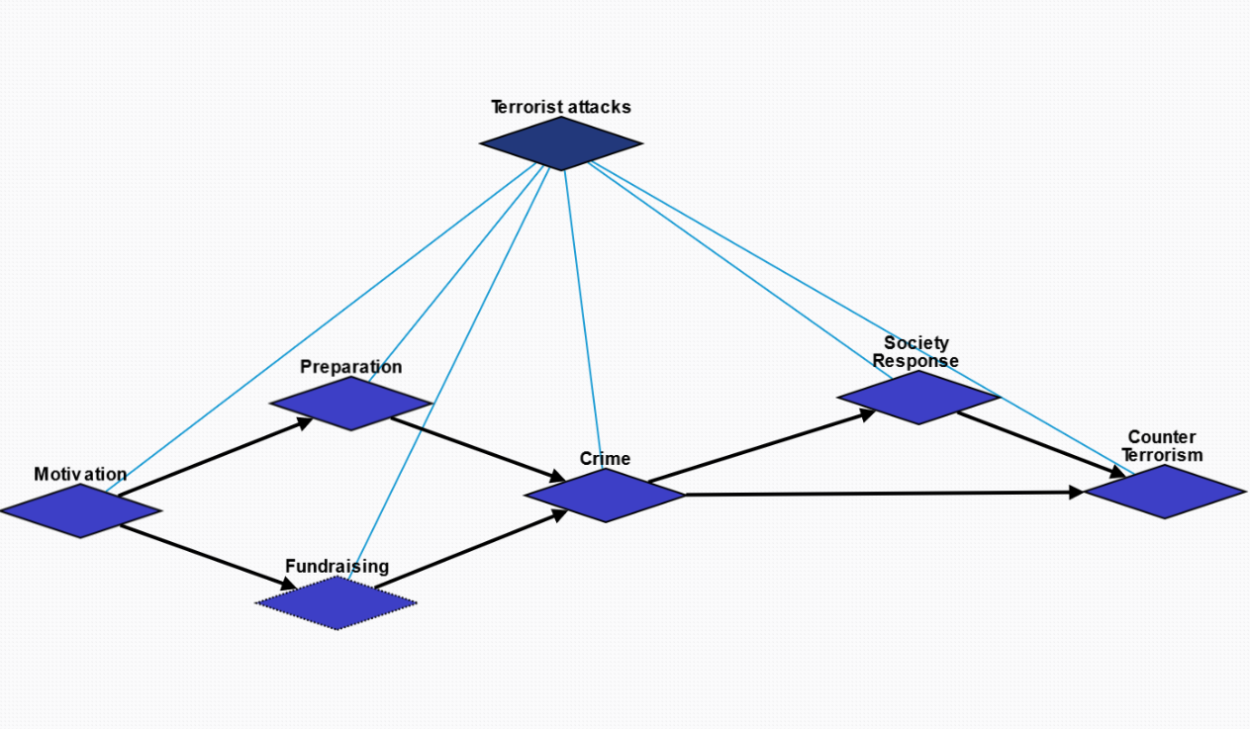
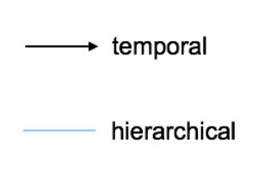
Overview

Slide 51
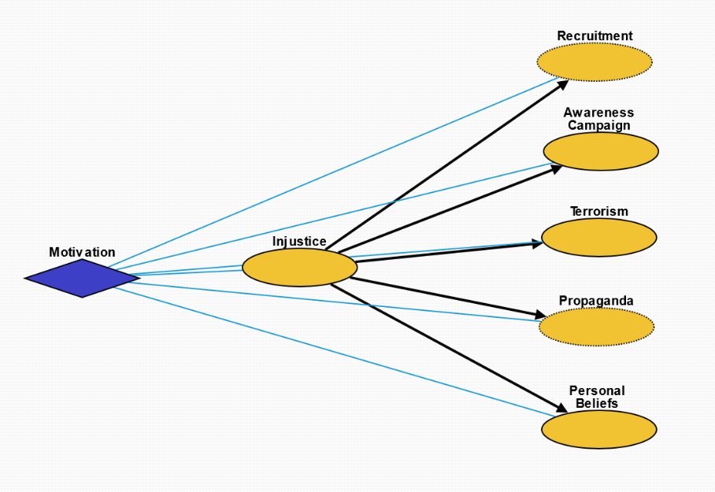
Motivation
Injustice: Injustice, whether objective or perceived, towards a group or individual.
Recruitment: Inspire people to join the cause.
Propaganda: Crime as propaganda to inspire people for the cause.
Awareness Campaign: Raise awareness and receive attention from the media on the cause.
Terrorism: Incite fear in the general population.
Personal Beliefs: Personal beliefs that something about the world is inherently wrong.

Slide 52
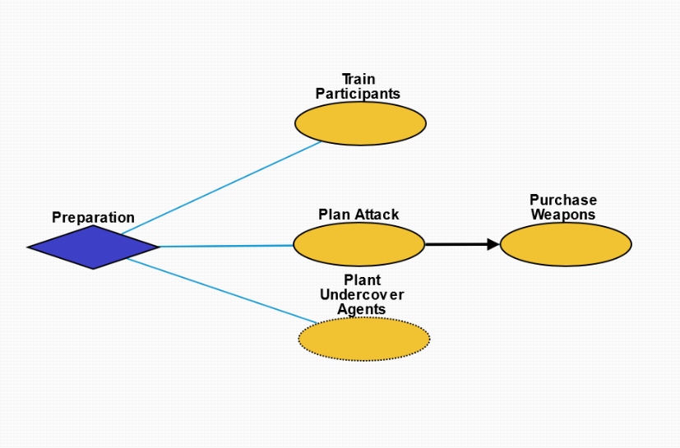
Preparation
Train Participants: Train participants who will execute the attack.
Plan Attack: Plan the specifics of attack.
Purchase Weapons: Obtain weapons for the crime.
Plant Undercover Agents: Plant spies in the target group to obtain information.

Slide 53
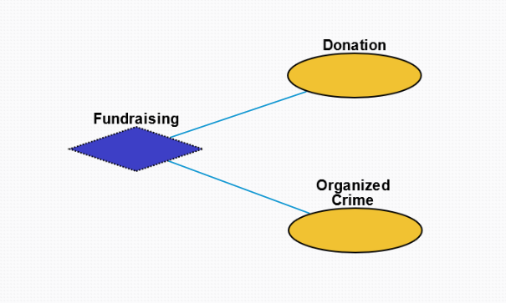
Fundraising
Donation: Monetary donation from supporters.
Organized Crime: Criminal enterprises for the purpose of profit.

Slide 54
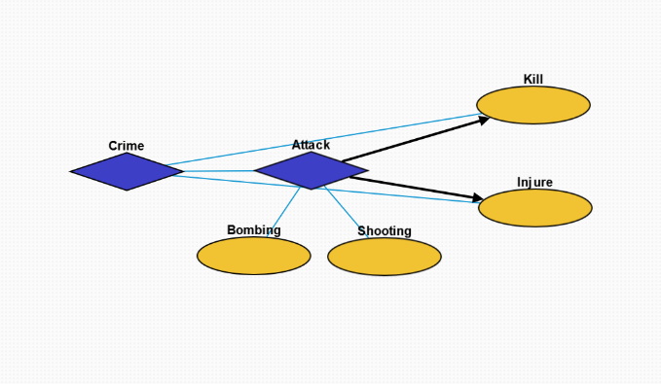
Crime
Attack: Terrorist action to injure another organism.
Bombing: Action whereby a bomb is used to kill one or more people or to damage or destroy objects
Shooting: Act or process of firing firearms or other projectile weapons
Kill: Killing an individual or group.
Injure: Injuring an individual or group.

Slide 55
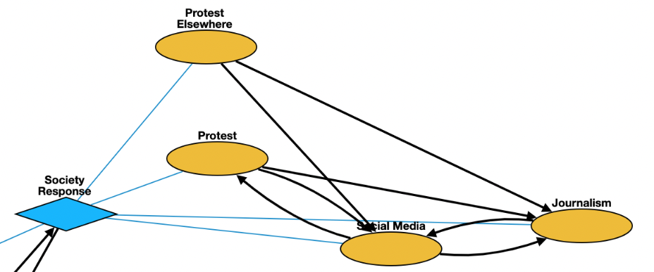
Society Response
Protest: Collective action by people to protest the terrorist attack and injustice.
Protest Elsewhere: protests that do not happen at the place of the attack
Social Media: Interaction among people in which they create, share, and/or exchange information and ideas in virtual communities and networks.
Journalism: Investigation and reporting of events, issues and trends to a broad audience.

Slide 56
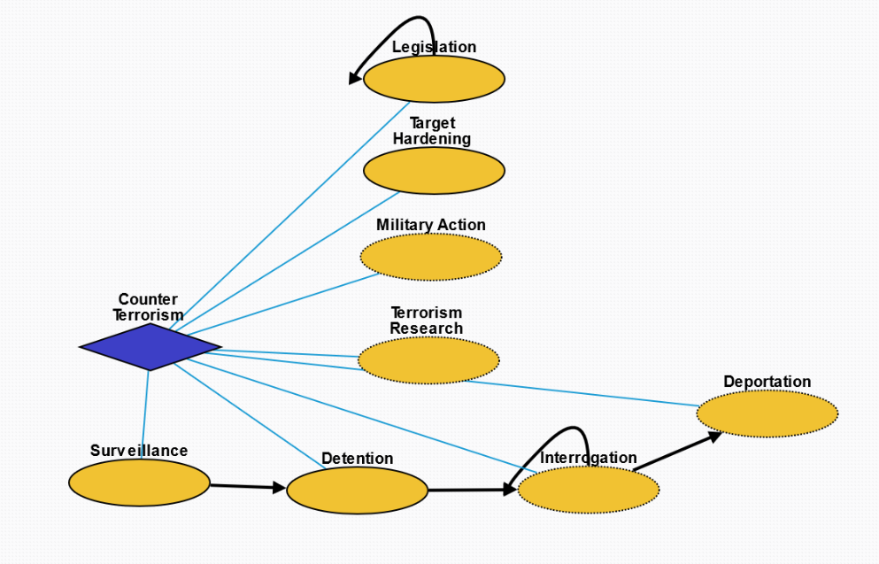
Counter Terrorism
Legislation: Laws enacted against terrorism.
Target Hardening: Process of securing or strengthening security of an area suspected to be targeted by terrorism.
Military Action: Control of people by others through violence in order to prevent further terrorist activity.
Terrorism Research: Systematic research into the cause of terrorism and its impact as well as preventative measures.
Surveillance: Monitoring of behavior, activities, or other changing information, for the purpose of influencing, managing or directing.
Detention: Removal of the freedom of liberty by a state.
Interrogation: Interviewing employed by law enforcement officers, military personnel, and intelligence agencies with the goal of eliciting information about affiliation with any terrorist group.
Deportation: Expulsion of the people from a place or country.

Slide 57
RESIN Terrorist Attacks Schema Updated March 20, 2022
Iris Liu, Sha Li, Michael Regan,
Susan Brown, Martha Palmer, Heng Ji

Slide 58
Overview

Slide 59
Motivation
Injustice: Injustice, whether objective or perceived, towards a group or individual.
Recruitment: Inspire people to join the cause.
Propaganda: Crime as propaganda to inspire people for the cause.
Awareness Campaign: Raise awareness and receive attention from the media on the cause.
Terrorism: Incite fear in the general population.
Personal Beliefs: Personal beliefs that something about the world is inherently wrong.

Slide 60
Preparation
Train Participants: Train participants who will execute the attack.
Plan Attack: Plan the specifics of attack.
Purchase Weapons: Obtain weapons for the crime.
Plant Undercover Agents: Plant spies in the target group to obtain information.

Slide 61
Fundraising
Donation: Monetary donation from supporters.
Organized Crime: Criminal enterprises for the purpose of profit.

Slide 62
Crime
Attack: Terrorist action to injure another organism.
Bombing: Action whereby a bomb is used to kill one or more people or to damage or destroy objects
Shooting: Act or process of firing firearms or other projectile weapons
Kill: Killing an individual or group.
Injure: Injuring an individual or group.

Slide 63
Society Response
Protest: Collective action by people to protest the terrorist attack and injustice.
Protest Elsewhere: protests that do not happen at the place of the attack
Social Media: Interaction among people in which they create, share, and/or exchange information and ideas in virtual communities and networks.
Journalism: Investigation and reporting of events, issues and trends to a broad audience.

Slide 64
Counter Terrorism
Legislation: Laws enacted against terrorism.
Target Hardening: Process of securing or strengthening security of an area suspected to be targeted by terrorism.
Military Action: Control of people by others through violence in order to prevent further terrorist activity.
Terrorism Research: Systematic research into the cause of terrorism and its impact as well as preventative measures.
Surveillance: Monitoring of behavior, activities, or other changing information, for the purpose of influencing, managing or directing.
Detention: Removal of the freedom of liberty by a state.
Interrogation: Interviewing employed by law enforcement officers, military personnel, and intelligence agencies with the goal of eliciting information about affiliation with any terrorist group.
Deportation: Expulsion of the people from a place or country.

Slide 65
Business Change Schema
Iris Liu
iris.liu@colorado.edu

Slide 66
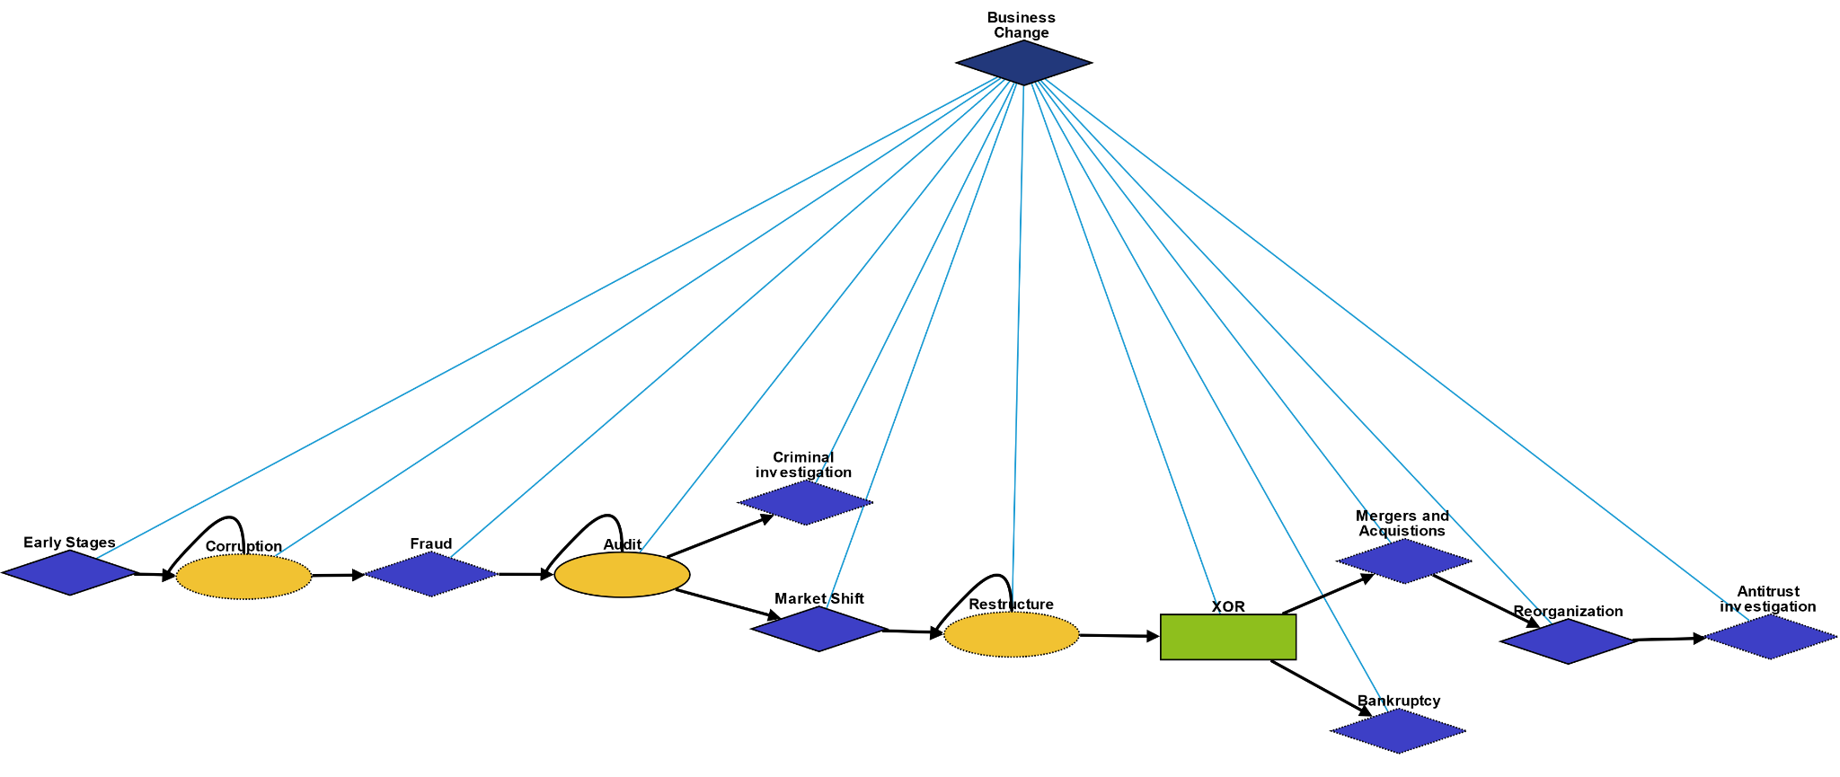
Overview
Early Stages: Events happening in the early stages of a business
Corruption: Some form of corruption happens amongst the people in the business
Fraud: Types of business fraud
Audit:Type of audit conducted to ensure "financial statements" are in accordance with specified criteria
Criminal investigation: Financial records could not be validated, a criminal investigation case is opened
Market Shift: Events leading to the business suffering economically
Restructure: Company restructures to avoid bankruptcy
Mergers and Acquisitions: Process to merge or be acquired by another company
Bankruptcy: Process in which a business files bankruptcy
Reorganization: Legal process after M&A or filing bankruptcy
Antitrust investigation: The government may sue a business if they have reason to believe the business is becoming a monopoly

Slide 67
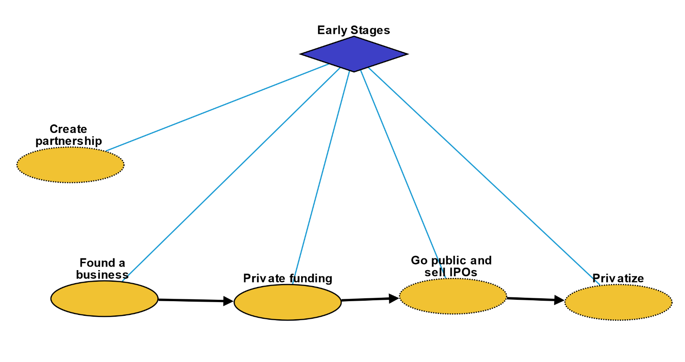
Early Stages
Create partnership: Two companies form a partnership, but remain separate entities
Found a business: A person founds a business
Private funding: Company is funded by private investors
Go public and sell IPOs: Company goes public and lists stock on the public market
Privatize: Company goes private and sells all their stock to a private equity firm

Slide 68
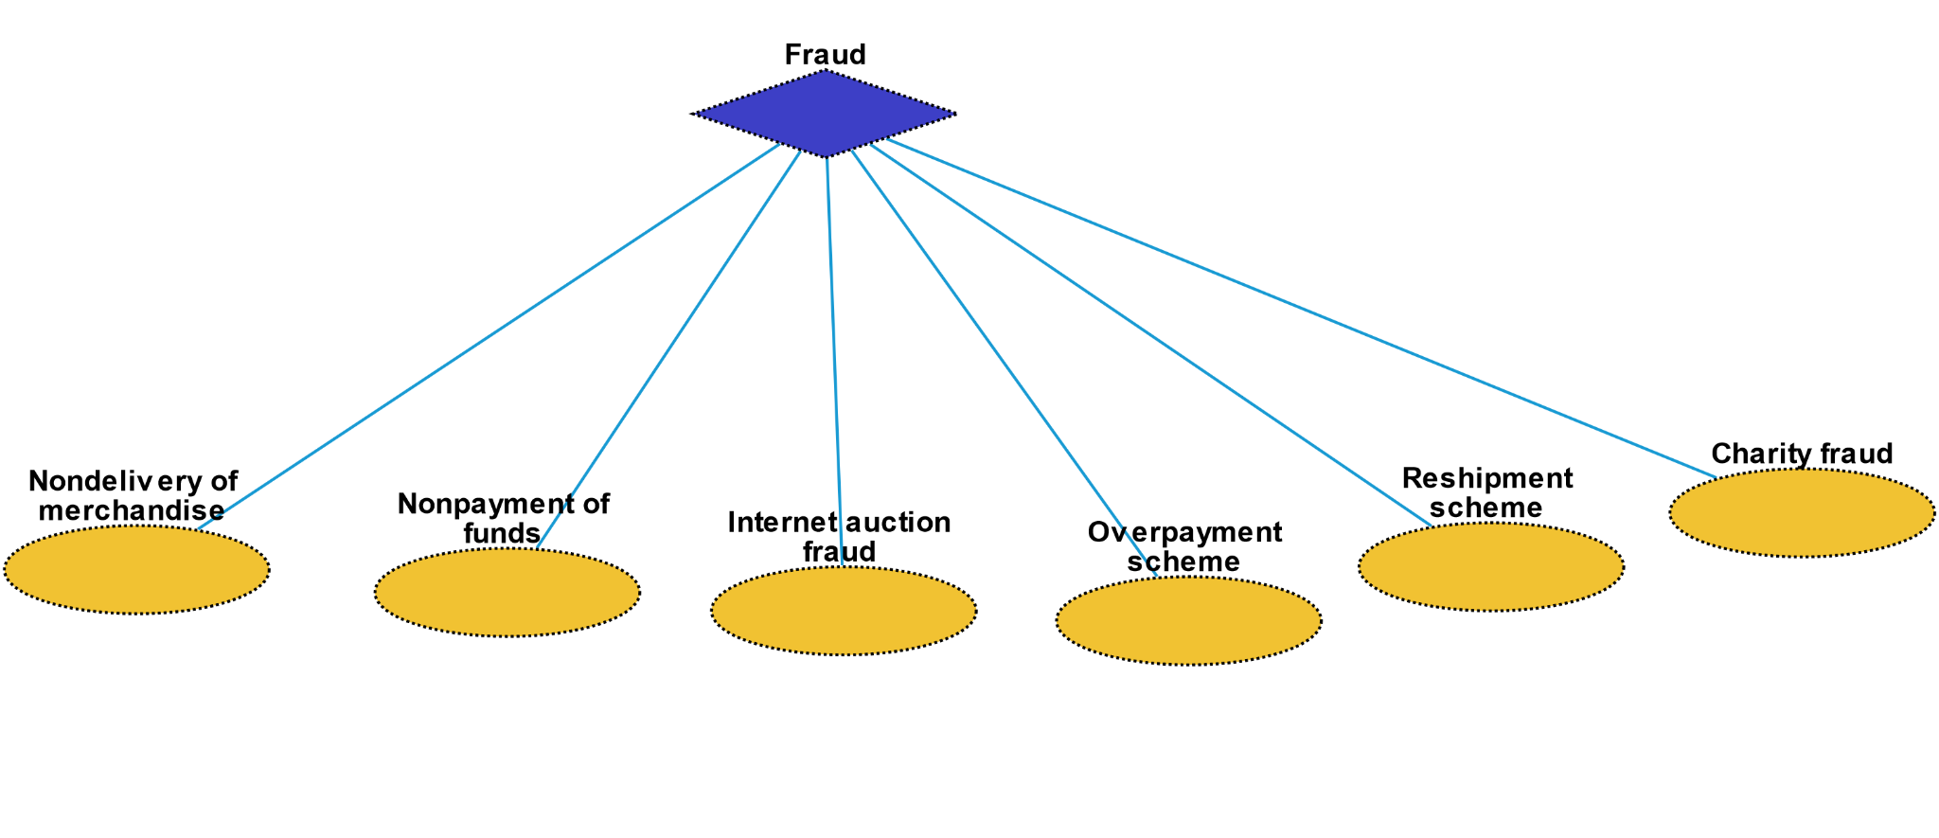
Fraud
Non-delivery of merchandise: Fraud occurring when a payment is sent but the goods and services ordered are never received.
Non-payment of funds: Fraud occurring when goods and services are shipped or rendered but payment for them is never received.
Internet auction fraud: A fraudulent transaction or exchange that occurs in the context of an online auction site.
Overpayment scheme: An individual is sent a payment significantly higher than an owed amount and is instructed to deposit the money in their bank account and wire transfer the excess funds back to the bank of the individual or company that sent it.
Reshipment scheme: An individual is recruited to receive merchandise at their place of residence and subsequently repackage the items for shipment, usually abroad.
Charity fraud: Using deception to get money from individuals believing they are making donations to legitimate charity organizations, especially charities representing victims of natural disasters shortly after the incident occurs.

Slide 69
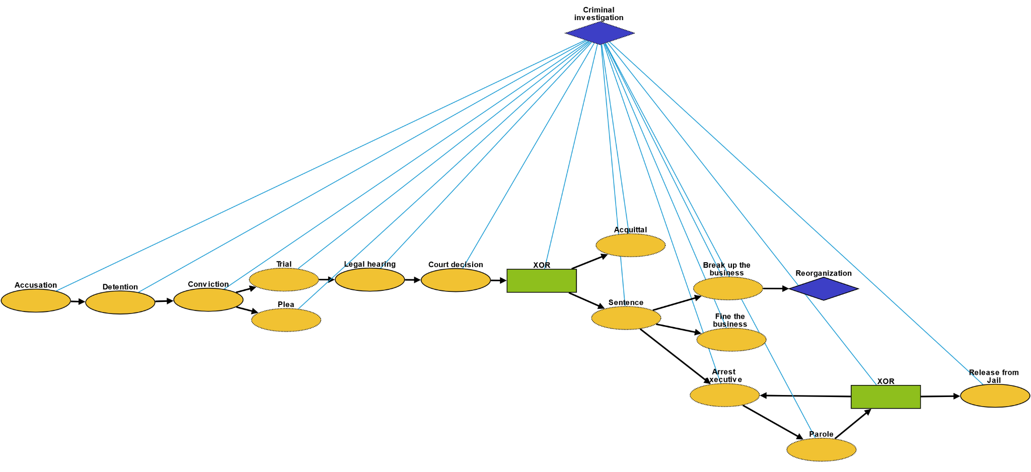
Criminal Investigation
Accusation: act of accusing or charging another with a crime
Detention: removal of the freedom of liberty by a state
Conviction: verdict that results when a court of law finds a defendant guilty of a crime
Plea: answer to a claim made by someone in a criminal case under common law using the adversarial system
Trial: coming together of parties to a dispute, to present information in a tribunal
Legal hearing: A legal hearing
Court decision: formal decision made by a court
Acquittal: the legal result of a verdict of not guilty
Sentence: decree of punishment in law
Break up the business: Government breaks company up into multiple, smaller companies
Fine the business: Government fines the business
Arrest executive: Goverment arrests an executive of the company
Parole: Executive goes on parole
Release from Jail: Executive is officially released

Slide 70
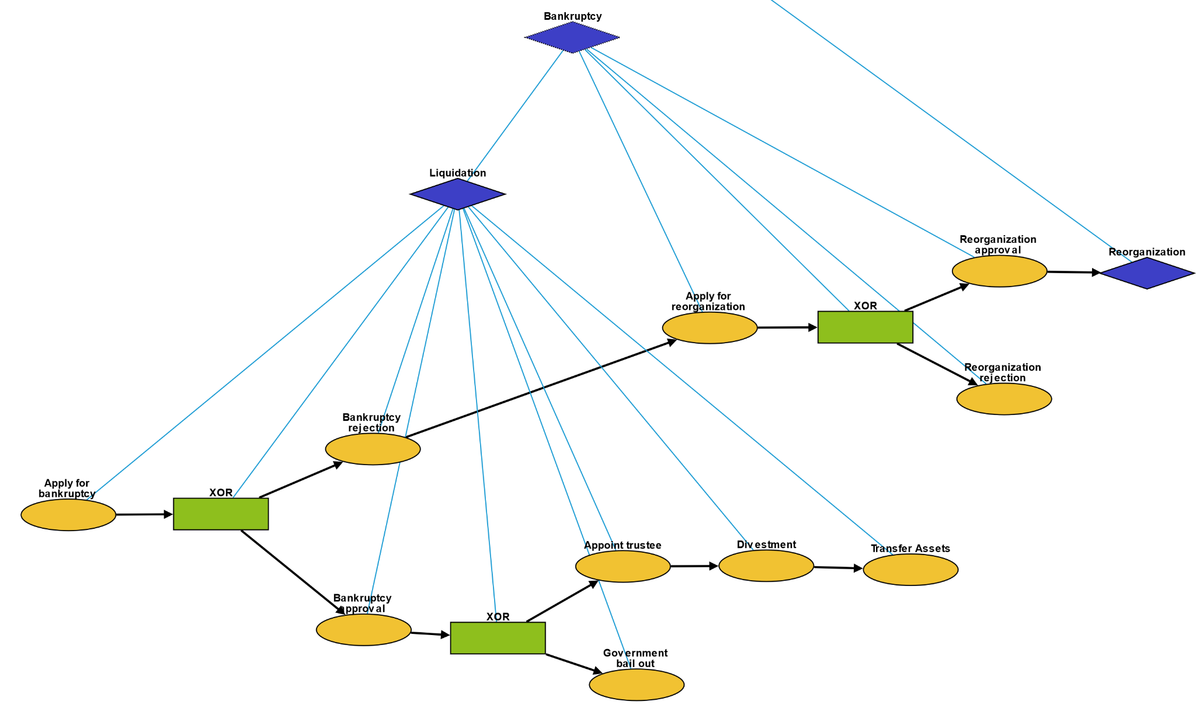
Bankruptcy
Apply for bankruptcy: Company officially applies for bankruptcy
Bankruptcy approval: Government approves the bankruptcy
Bankruptcy rejection: Government rejects the bankruptcy
Appoint trustee: Government appoints a trustee to oversee the reorganization
Divestment: Trustee liquidates assets
Transfer assets: Trustee distributes assets to creditors
Government bail out: Government lends company money, because the company bankruptcy would damage the economy
Apply for reorganization: Company officially applies for reorganization
Reorganization approval: Government approves the reorganization
Reorganization rejection: Government rejects the reorganization

Slide 71
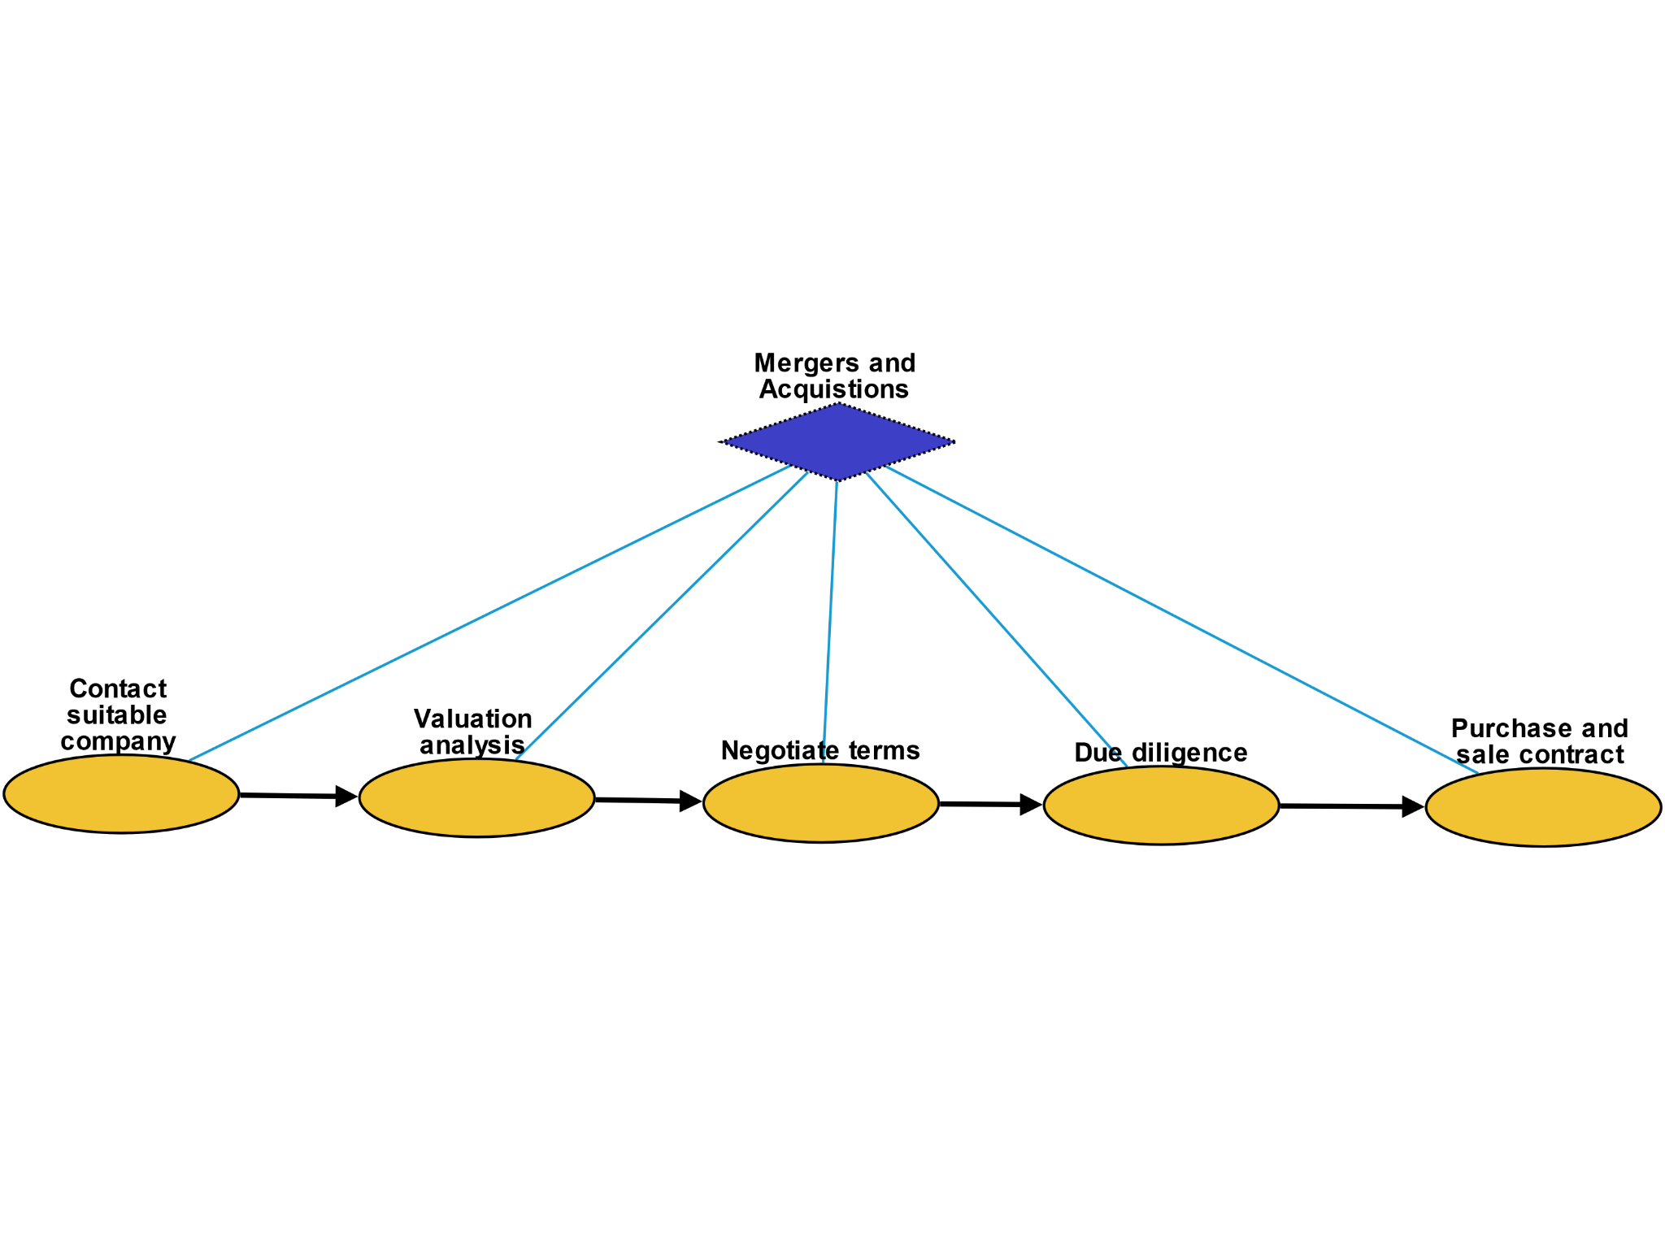
Mergers and Acquisitions
Contact suitable company: A company contacts a candidate company to propose merge / acquisition
Valuation analysis: Company performs valuation on the candidate company
Negotiate terms: Companies negotiate terms of merge / acquisition
Due diligence: Company performs due diligence on candidate company
Purchase and sale contract: Companies sign a contract and officially merge / become acquired

Slide 72

Reorganization
Terminate contracts and leases: Company terminates some contracts and leases
Repay some debt: Company repays some debt to its creditors
Recover assets: Liquidate or re-use some assets
Management change: A new CEO or executive is hired
Dismiss employees: Company fires some employees
Hire new talent: Company hires new talent

Slide 73

Antitrust Investigation
Contact attorney: Government contacts attorney to begin filing a lawsuit
File complaint: Plaintiff files a complaint to initiate a lawsuit
Answer: In law, a solemn assertion in opposition to someone or something by the defendant
Discovery: Pre-trial procedure in common law countries for obtaining evidence
Motion: In US law, a procedural device to bring a limited, contested issue before a court for decision
Mediation: Dispute resolution with assistance of an impartial third party moderator throughthe use of communication and negotiation techniques
Settlement: The dispute is resolved through a payment of money.
Trial: Coming together of parties to a dispute, to present information in a tribunal
Judgement: The formal decision made by a court following a lawsuit
Appeal: Resort to a superior court to review the decision of an inferior court or administrative agency

Slide 74
RESIN Election Schema Quizlet 9
Charles Yu

Slide 75

Overview

Slide 76

Nomination episode
Nomination – container for the episode Declare candidacy – a person declares themselves a candidate for nomination
Nomination campaign – container for a repeatable sub-episode of campaigning Campaign for nomination – a candidate campaigns throughout the political region Debate – a candidate attends debates with other candidates to clarify their political platform
Gather information – a candidate or related parties may gather information via polling/surveying to find what location and issues to prioritize Drop out – a candidate may drop out of the race Endorse candidate – a candidate who has dropped out will typically endorse a different candidate whose views best align with theirs
Continue campaign – during the campaign, as more information is revealed, a candidate may decide to continue campaigning Unofficially nominated – a candidate is unofficially nominated (i.e., they received a majority of votes already) Announce running mate – a candidate will announce their running mate for their ticket Party convention – a political party will hold a convention to discuss their overall platform for the election Officially nominated – a candidate is officially declared a party’s nominee Official campaign – next episode

Slide 77

Official campaign episode
Official campaign – container for the episode Debate – candidate will attend debates with other candidates Campaign – candidate will hold rallies or meet and greets to generate support Speech – a candidate will give a speech about their platform to generate hype and support Fundraising – candidate will (optionally) raise funds to support their campaign
Media appearance – candidate will appear in the media via interviews and events Advertising – candidate will run advertisements to reach a wider audience Voting – next episode

Slide 78

Voting episode
Voting – container for the episode
Vote – container for the event encompassing the process of a vote Mail in ballot – some voters will mail in a ballot to vote Vote early – some voters will follow a special process to vote early Go to polling site – some voters will vote on election day at the polling site Votes verified – votes are counted and verified to prevent fraud Winner declared – the winner of the election is declared based on the votes
Conclusion – next episode

Slide 79

Conclusion episode
Conclusion – container for the episode Inauguration – the winner of the election is inaugurated Reject result – a loser of the election may deny the result of the election Lawsuit – a loser of the election may sue in order to attempt to overturn the result Incite violence – a loser of the election may incite violence to try to overturn the result Coup d'état – a loser of the election may attempt a coup

Slide 80
RESIN Sports_Games Schema

Slide 81


Overview

Slide 82

Preparation
Bids for hosting the event: for major sports events, such as modern Olympics games and various National Games, nations or cities should put forth bids for hosting the event.
Announcement of the event: the decision of bids are typically announced through a press conference.
Competition scheduling: to schedule the grouping and matching of participating teams, and settling down the time and location of matches.
Boycott the event: sometimes certain nations or individual athletes will boycott a sports game for political or humanitarian reasons.
Training of participating athletes: before major competitions, athletes needs specific training to achieve better performance.

Slide 83

Sports Event
Opening ceremony: opening ceremony represents the official commencement of a major sports event.
Sports competition: a specific competition in which the participants rival with each other to win the game
Overtime (extra time): Overtime or extra time is an additional period of play specified under the rules of a sport to bring a game to a decision and avoid declaring the match a tie or draw where the scores are the same.
Violence in sports: violent and often unnecessarily harmful intentional physical acts committed during, or motivated by, a sports game. This may include violence between athletes or fan violence.
Closing ceremony: the official ceremony which marks the end of the sports event.

Slide 84

Social Response
Press release: the official general post-match press conference for each match, covering topics related to the event, such as commentary, opinions, and fan responses.
Interview: (mostly after winning) athletes and coaches are interviewed about feelings and critical success factors, etc.
War triggered by a sports event: in very rare cases, the riots happened in a sports game will escalate to wars between participating nations, such as the 1969 Football War between El Salvador and Honduras.

Slide 85
RESIN Terrorist Mass Shooting Schema Updated March 20, 2022
Ghazaleh Kazeminejad, Sha Li, Iris Liu, Michael Regan,
Susan Brown, Martha Palmer, Heng Ji

Slide 86

Overview

Slide 87

Motive
Failure: state or event of not meeting a desirable or intended objective, relative to a particular observer or belief system
Social conflict: struggle for agency or power in society, when two or more actors oppose each other in social interaction
Revenge: harmful action in response to a grievance

Slide 88

Planning
Intentional human activity: human activity driven by purposeful motives
Decision: result of deliberation
Buy: purchase weapon for crime
Announcement: printed, spoken, or published statement or notice of intent of mass shooting

Slide 89

Attack
Motion: change in position of an object over time; a body is said to be in motion if it changes its position with respect to its immediate surroundings
Gun violence: broadly defined as violence committed with the use of a gun
Injury: physiological wound caused by shooter
Killing: act of killing a living being
Survival: act of being still alive after a threatening or dangerous situation
Violent death: death caused by violence through the shooting

Slide 90

Medical Response
Emergency call: way of contacting an emergency call center usually by a phone to an emergency telephone number
Driving: operation of a vehicle to the crime scene
First aid: first and immediate assistance given to any person suffering from shooting injury
Rescue: comprises responsive operations that usually involve the saving of life, or prevention of injury

Slide 91

Criminal Investigation
Accusation: act of accusing or charging another with a crime
Arrest: detention of a person and taking them into custody, usually because it has been suspected of committing a crime
Detention: removal of the freedom of liberty by a state
Conviction: verdict that results when a court of law finds a defendant guilty of a crime
Plea: answer to a claim made by someone in a criminal case under common law using the adversarial system
Trial: coming together of parties to a dispute, to present information in a tribunal
Legal hearing: A legal hearing about the crime
Court decision: formal decision made by a court
Acquittal: the legal result of a verdict of not guilty
Sentence: decree of punishment in law
Imprisonment: restraint of a person's liberty by judicial or other detention
Execution: homicide as capital punishment

Slide 92
RESIN Civil Unrest Schema
Curated by Yizhu Jiao
Updated March 20, 2022

Slide 93

Overview

Slide 94

Trigger
Crime: crimes that seriously threaten social security and cause widespread concerns
Election: the results of the election did not meet the expectations of some people or the fairness of the election was questioned
War: people suffer from injustice or protracted wars
Legislation: the legal provisions are unreasonable or against the requirements of some people
Trial: trials of legal cases do not meet public expectations

Slide 95

Peaceful Protest
Inquiry: people seek more information about the trigger
Investigation: people investigate the process or truth of the trigger
Negotiation: protesters try to communicate and negotiate to look for a solution
Demonstration: protest activity taking the form of a public gathering of people in a rally or walking in a march
Strike: workers refuse to work as a typical form of protest to gain a concession
Occupation: protesters hold public spaces or critical infrastructure as an act of protest

Slide 96

Riot [optional]
Clash: Protesters clash with police
Disperse: police ordered the crowd to disperse
Robbery: protesters looted surrounding shops or residents
Arson: protesters set fire to surrounding buildings or objects
Destruction: protesters causing damage to residents' property
Shoot: police shoot criminals to maintain order
Injury: people get injured in conflict
Death: people die in conflict
Attack: protesters attack police during clash
Emergency_evacuation: residents evacuated from burning or destroyed buildings

Slide 97

Justice
Arrest: police arrest some criminal or protester
Conviction: protester guilty of breaking the law
Sentence: protesters for breaking the law sentenced
Release: protesters with minor or no offenses released

Slide 98

Response
Resignation: the directors responsible for the incidence resign from the position
Public statement: the head of government makes a public speech to call for clam and provide resolutions to the problem
Investigation: head of government promises to re-investigate to meet public expectations

Slide 99
RESIN International Conflict Schema

Slide 100

Overview: International Conflict
Three major episodes:
Background
War
Negotiation

Slide 101

Episode Background
Remote Communication
Threat: one person's statement that they intend to harm another, or another's property
Announcement: printed, spoken, or published statement or notice of an event or other news
Negotiation: dialogue between two or more people or parties intended to reach a beneficial outcome
Economic Crisis: sharp deterioration in economic situation and perspectives
Assassination: murder of a prominent person, often a political leader or ruler
Revolution: fundamental change in power or organizational structures that takes place in a relatively short period of time
Civil Disorder: civil unrest against war
Intention: a country has the intention to join an organization
Conflict: friction, disagreement, or discord within a group or between different groups

Slide 102

Episode War
Five sub-episodes:
Government Action
Civilian Reaction
International Response
Economic Impact
Battle

Slide 103

War: Government Action
Nuclear Threat: a type of threat
Propaganda: form of communication intended to sway the audience through presenting only one side of the argument
Accusation
Announcement: announcing war
Military Mobilization: assembling and readying troops and supplies for war
Conscription: compulsory enlistment into national or military service
Convocation: assemble army
Military Deployment: deploying troops
Transport: transporting troops
Invasion: entering territory
Temporarily Closed: facility shutdown
Cyber Attack: cyber crime
Censorship: practice of suppressing speech or other public communication

Slide 104

War: Civilian Reaction
Fundraising: process of gathering voluntary contributions of money or other resources
Reconstruction: rebuild infrastructure
Resource Allocation: allocation of resources among possible uses
Demonstration: demonstration against war
Arrest: arresting protesters
Transport
Escape: flee to other countries
Medical Evacuation: evacuate refugee
Emergency Evacuation: seeking asylum
Housing: seeking shelter for bombing
Conscription: enlist for the army
First Aid: first and immediate assistance given to any person suffering from either a minor or serious illness or injury

Slide 105

War: International Response
Arms trade: purchase weapons
Transport: transport weapons for support
Speech: government leader gives speech
Advocacy: call for ceasefire
Filing: file a case for war crime
Boycott: act of voluntarily abstaining from using, buying, or dealing with a person, organization, or country
Journalism: media coverage
Human Migration: refugee migration
Censure: condemn at social media
Housing: refugee housing
Economic Support: economic benefit paid to persons who cannot support themselves
Donation: gift given by physical or legal persons, typically for charitable purposes and/or to benefit a cause
Supply: economic activity aimed at covering the consumption needs of an economic unit
Economic Sanctions: international economic sanctions
Financial Crisis: domestic and international financial crisis
Military Intervention: use of force by a State over foreign territory
Demonstration: protest against war

Slide 106

War: Economic Impact
Banking Crisis: abrupt instability in the banking industry
Business Failure: a company ceasing operations following its inability to make a profit or to bring in enough revenue to cover its expenses
Temporarily Closed: state that indicates that a building, installation, park, etc. is not accessible because it is closed
Bankruptcy: legal process through which people or other entities who cannot repay debts to creditors may seek relief from some or all of their debts
Recession: business cycle contraction; general slowdown in economic activity
Scarcity: resource scarcity
Stock Market Crash: sudden dramatic decline of stock prices across a significant cross-section of a stock market

Slide 107

War: Battle
Air-to-surface Warfare: military mission utilizing aircraft to combat enemy forces on land or at sea
Aerial Warfare: warfare and military operations conducted by, amongst, and against aircraft and other aerial systems
Aircraft Shootdown: shooting down of a civilian or military aircraft
Bombardment
Drone Strike: conventional combat mission on an individual or small-scale basis
Bombing: attack by artillery fire or by dropping bombs from aircraft
Result of Attack
Conflagration: large and destructive fire that threatens human life, animal life, health, and/or property
Die: death
Injure: injury
Destruction: damage to an object, system or an idea
Landing Operation: type of military action
Defense: protection from attack in military operations
Besiege: military blockade of a city or fortress
Blockage: effort to cut off supplies from a particular area by force
Military Occupation: effective provisional control of a certain power over a territory

Slide 108

Episode Negotiation
Remote Communication: a third-party organization requests ceasefire
Negotiation: battle participants negotiate a ceasefire agreement
Negotiation Outcome: a container
Rejection: battle participants do not reach an agreement on ceasefire
Agreement: battle participants reach an agreement
Announcement: announcing the ceasefire agreement
Withdrawal: withdrawing the attacking army
Ceasefire: temporary stoppage of war
Signature: signing of the ceasefire agreement
Dissolution: organization or country dissolves after negotiation
Dismissal: personnel change after negotiation

Slide 109
RESIN Disaster and Rescue Schema Updated March 22, 2022
Veronica Qing Lyu

Slide 110
Manmade Disaster and Rescue

Slide 111


Overview

Slide 112

Manmade disaster
Collapse: Collapse of a building etc., in a disaster
Conflagration: An area or building is set on fire.
Trap: victims are trapped in the disaster site
Damage: Damage caused to buildings at the disaster site.
Injury: Victims are injured by the disaster.
Death: Victims die from the disaster.

Slide 113

Rescue
Announcement: government announces the disaster to public
Command: government commands rescuers to carry out rescue
Communication: rescuers communicate with trapped victims
Emergency evacuation: rescuers evacuate trapped victims
Collaboration: different parties of rescuers collaborate
Transport: rescuers transport victims to medical sites
Treatment: medical treatment of the victims
Recover: victims recover from injuries
Death: Patients die post treatment.

Slide 114

Investigation
Identifycategorize: Investigation of a manmade disaster includes identifying its initiators.
Contact: Make contact with the suspect
Arrest: Taking the suspect who caused the disaster into custody
Handcuffing: Using handcuffs to secure a suspect who initiated the disaster.
Restrain: Physical restraint on the suspect
Interrogation: Interviewing with the goal of eliciting useful information related to suspected crime
Inspect: Organized examination or formal evaluation on the initiator of the disaster.

Slide 115

Civil Justice
File Complaint: Plaintiff files a complaint to initiate a lawsuit
Answer: In law, a solemn assertion in opposition to someone or something by the defendant
Discovery: Pre-trial procedure in common law countries for obtaining evidence
Motion: In US law, a procedural device to bring a limited, contested issue before a court for decision
Mediation: Dispute resolution with assistance of an impartial third party moderator throughthe use of communication and negotiation techniques
Settlement: The dispute is resolved through a payment of money.
Trial: Coming together of parties to a dispute, to present information in a tribunal
Judgement: The formal decision made by a court following a lawsuit
Appeal: Resort to a superior court to review the decision of an inferior court or administrative agency

Slide 116
Natural Disaster and Rescue

Slide 117

Overview

Slide 118

Natural disaster
Tornado: violently rotating column of air that is in contact with both the earth's surface and a cumulonimbus cloud in the air
Flood: overflow of water that submerges land
Wildfire: uncontrolled fire in an area of combustible vegetation that occurs in the countryside or a wilderness area
Earthquake: result of a sudden release of energy in the Earth's crust that creates seismic waves
Tsunami: series of water waves caused by the displacement of a large volume of a body of water
Thunderstorm: type of weather
Trap: victims are trapped in the disaster site
Damage: changes introduced into a system that adversely affect its current or future performance

Slide 119
Rescue
Announcement: government announces the disaster to public
Command: government commands rescuers to carry out rescue
Communication: rescuers communicate with trapped victims
Emergency evacuation: rescuers evacuate trapped victims
Collaboration: different parties of rescuers collaborate
Transport: rescuers transport victims to medical sites
Treatment: medical treatment of the victims
Recover: victims recover from injuries
Death: Patients die post treatment.

